Slide 1
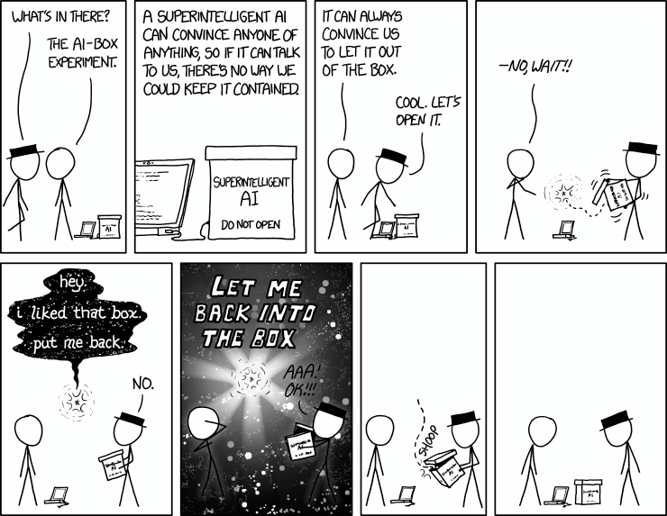

Generative AI: token generation
Xkdc
Machine Learning Methods for Biomedical Data (D012554)

Slide 2

GPT (Generative Pre-trained Transformer)
 | BERT | GPT
Type | Encoder-only | Decoder-only
Directionality | Bidirectional (reads both left and right context) | Autoregressive (left-to-right generation)
Self-Attention | Can attend to all tokens in input | Masked self-attention (only past tokens)
Primary Use | Understanding & classification | Text generation & completion
Ashish Vaswani et al., Attention is all you need. (NIPS'17)
Machine Learning Methods for Biomedical Data (D012554)

Slide 3
Input layer: token embeddings
Maps tokens to embedding vectors: converts tokenized words into dense, continuous vector representations for model processing.
Embeddings are learned during training.
Each token is represented as a vector of a fixed size.
Since transformers lack recurrence, positional encodings are added to embeddings to encode word order.
Token embeddings encode semantic meaning for each specific token.
GPT-3 uses a vocabulary of 50,257 tokens.
Machine Learning Methods for Biomedical Data (D012554)

Slide 4
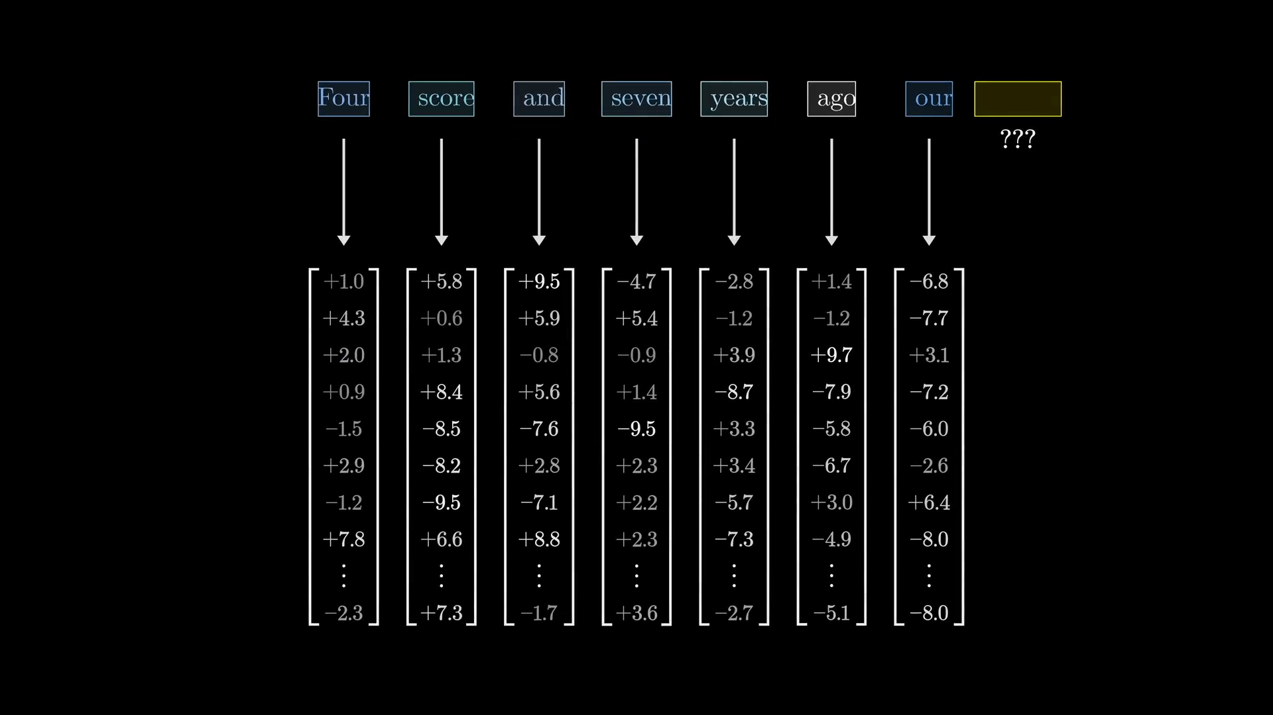

Slide 5
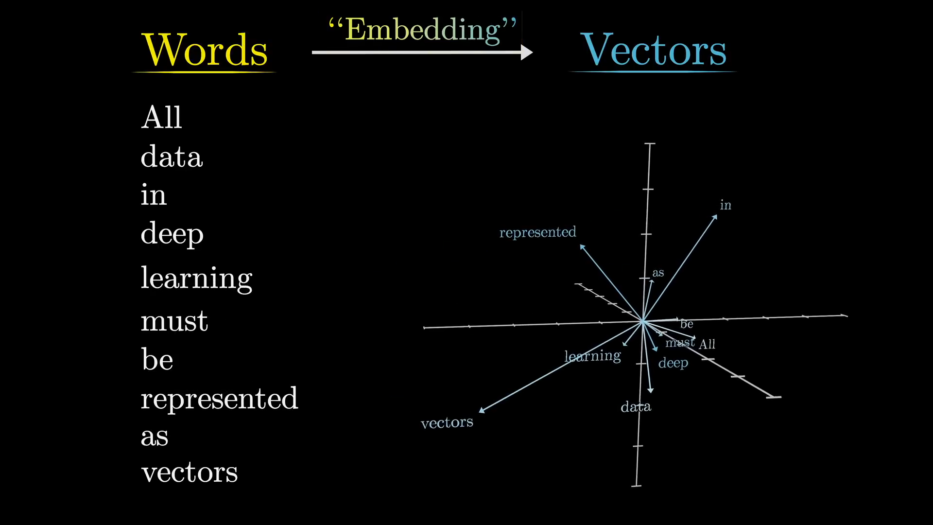

Slide 6
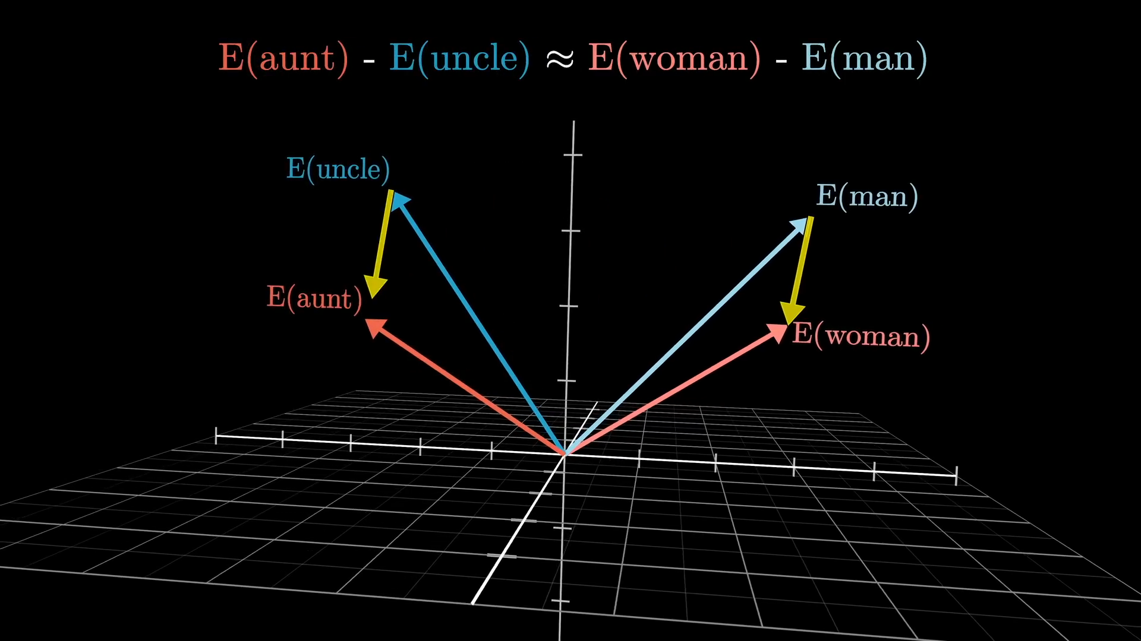

Slide 7
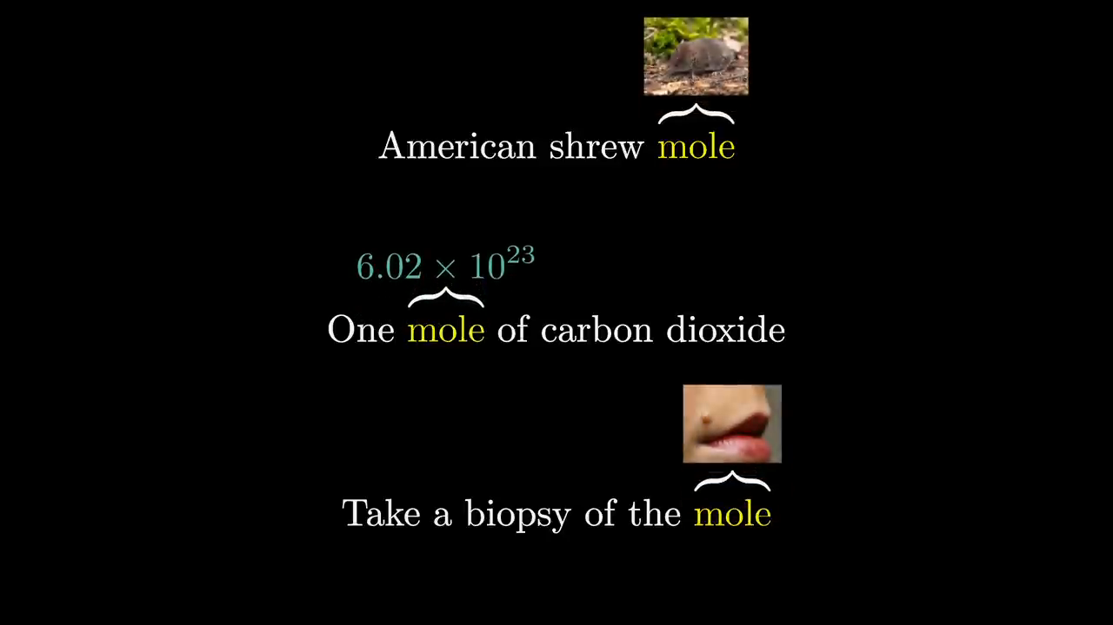

Slide 8
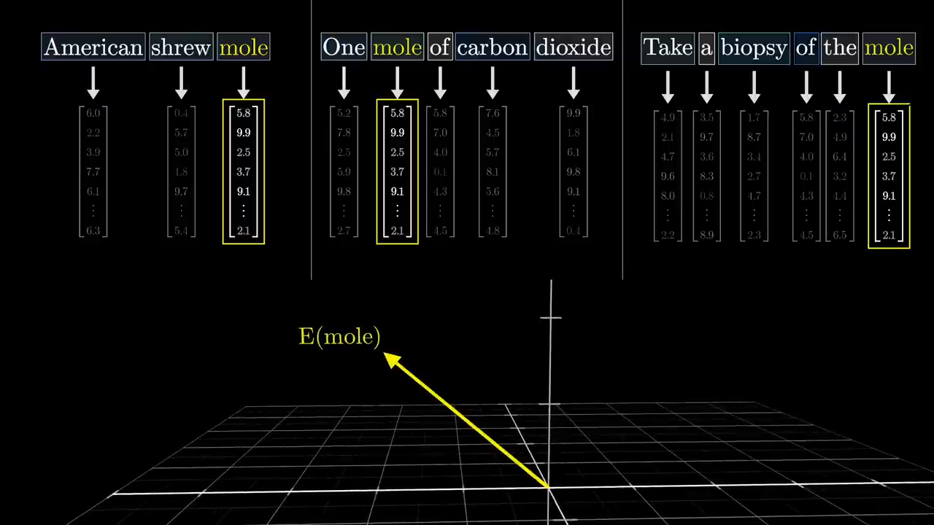

Slide 9

Positional encoding
Transformers lack inherent sequential processing like RNNs.
Positional encoding is added to allow the transformer to recognize relative positions and distances between tokens.
Machine Learning Methods for Biomedical Data (D012554)

Slide 10
Position encoding
Transformers lack inherent sequential processing like RNNs.
Positional encoding is added to allow the transformer to recognize relative positions and distances between tokens.
Instead of appending this positional information to the embedding vectors, the positional information is added to the embedding. This is more efficient, and the model can extract the positional information from the embedding at any time.
Machine Learning Methods for Biomedical Data (D012554)

Slide 11
Attention head
Assigns importance to other words: Each token attends to all other tokens in the sequence, determining which words influence its meaning.
Captures long-range dependencies: Unlike RNNs, which process text sequentially, self-attention can relate words far apart in a sentence.
Adjusts meaning based on context: The same word can have different meanings depending on surrounding words, and self-attention helps capture this nuance.
Creates context-aware representations: By combining information from different tokens, the attention head generates richer word embeddings that reflect their contextual meaning.
Machine Learning Methods for Biomedical Data (D012554)

Slide 12
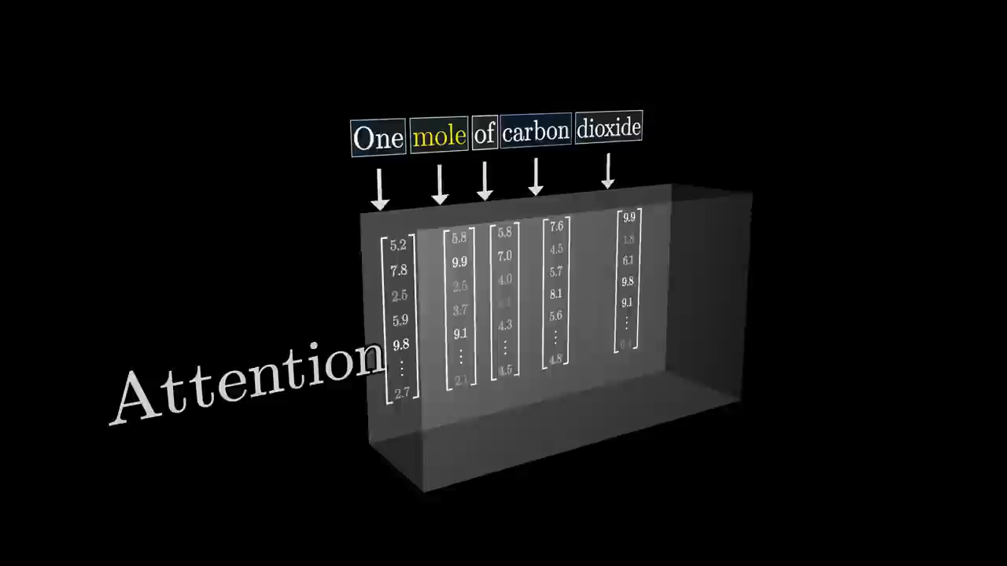

Slide 13
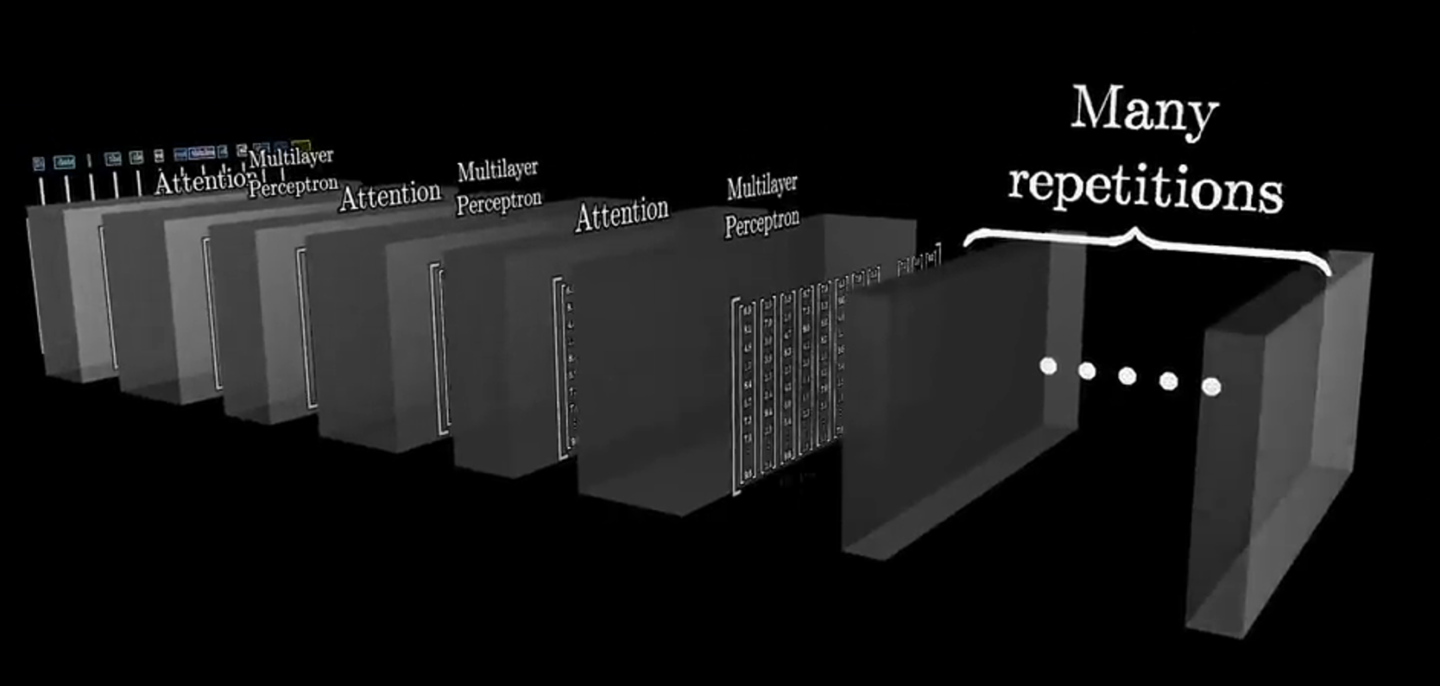
Attention head
The transformer architecture consists of multiple layers of (multi-)attention heads.
Machine Learning Methods for Biomedical Data (D012554)

Slide 14
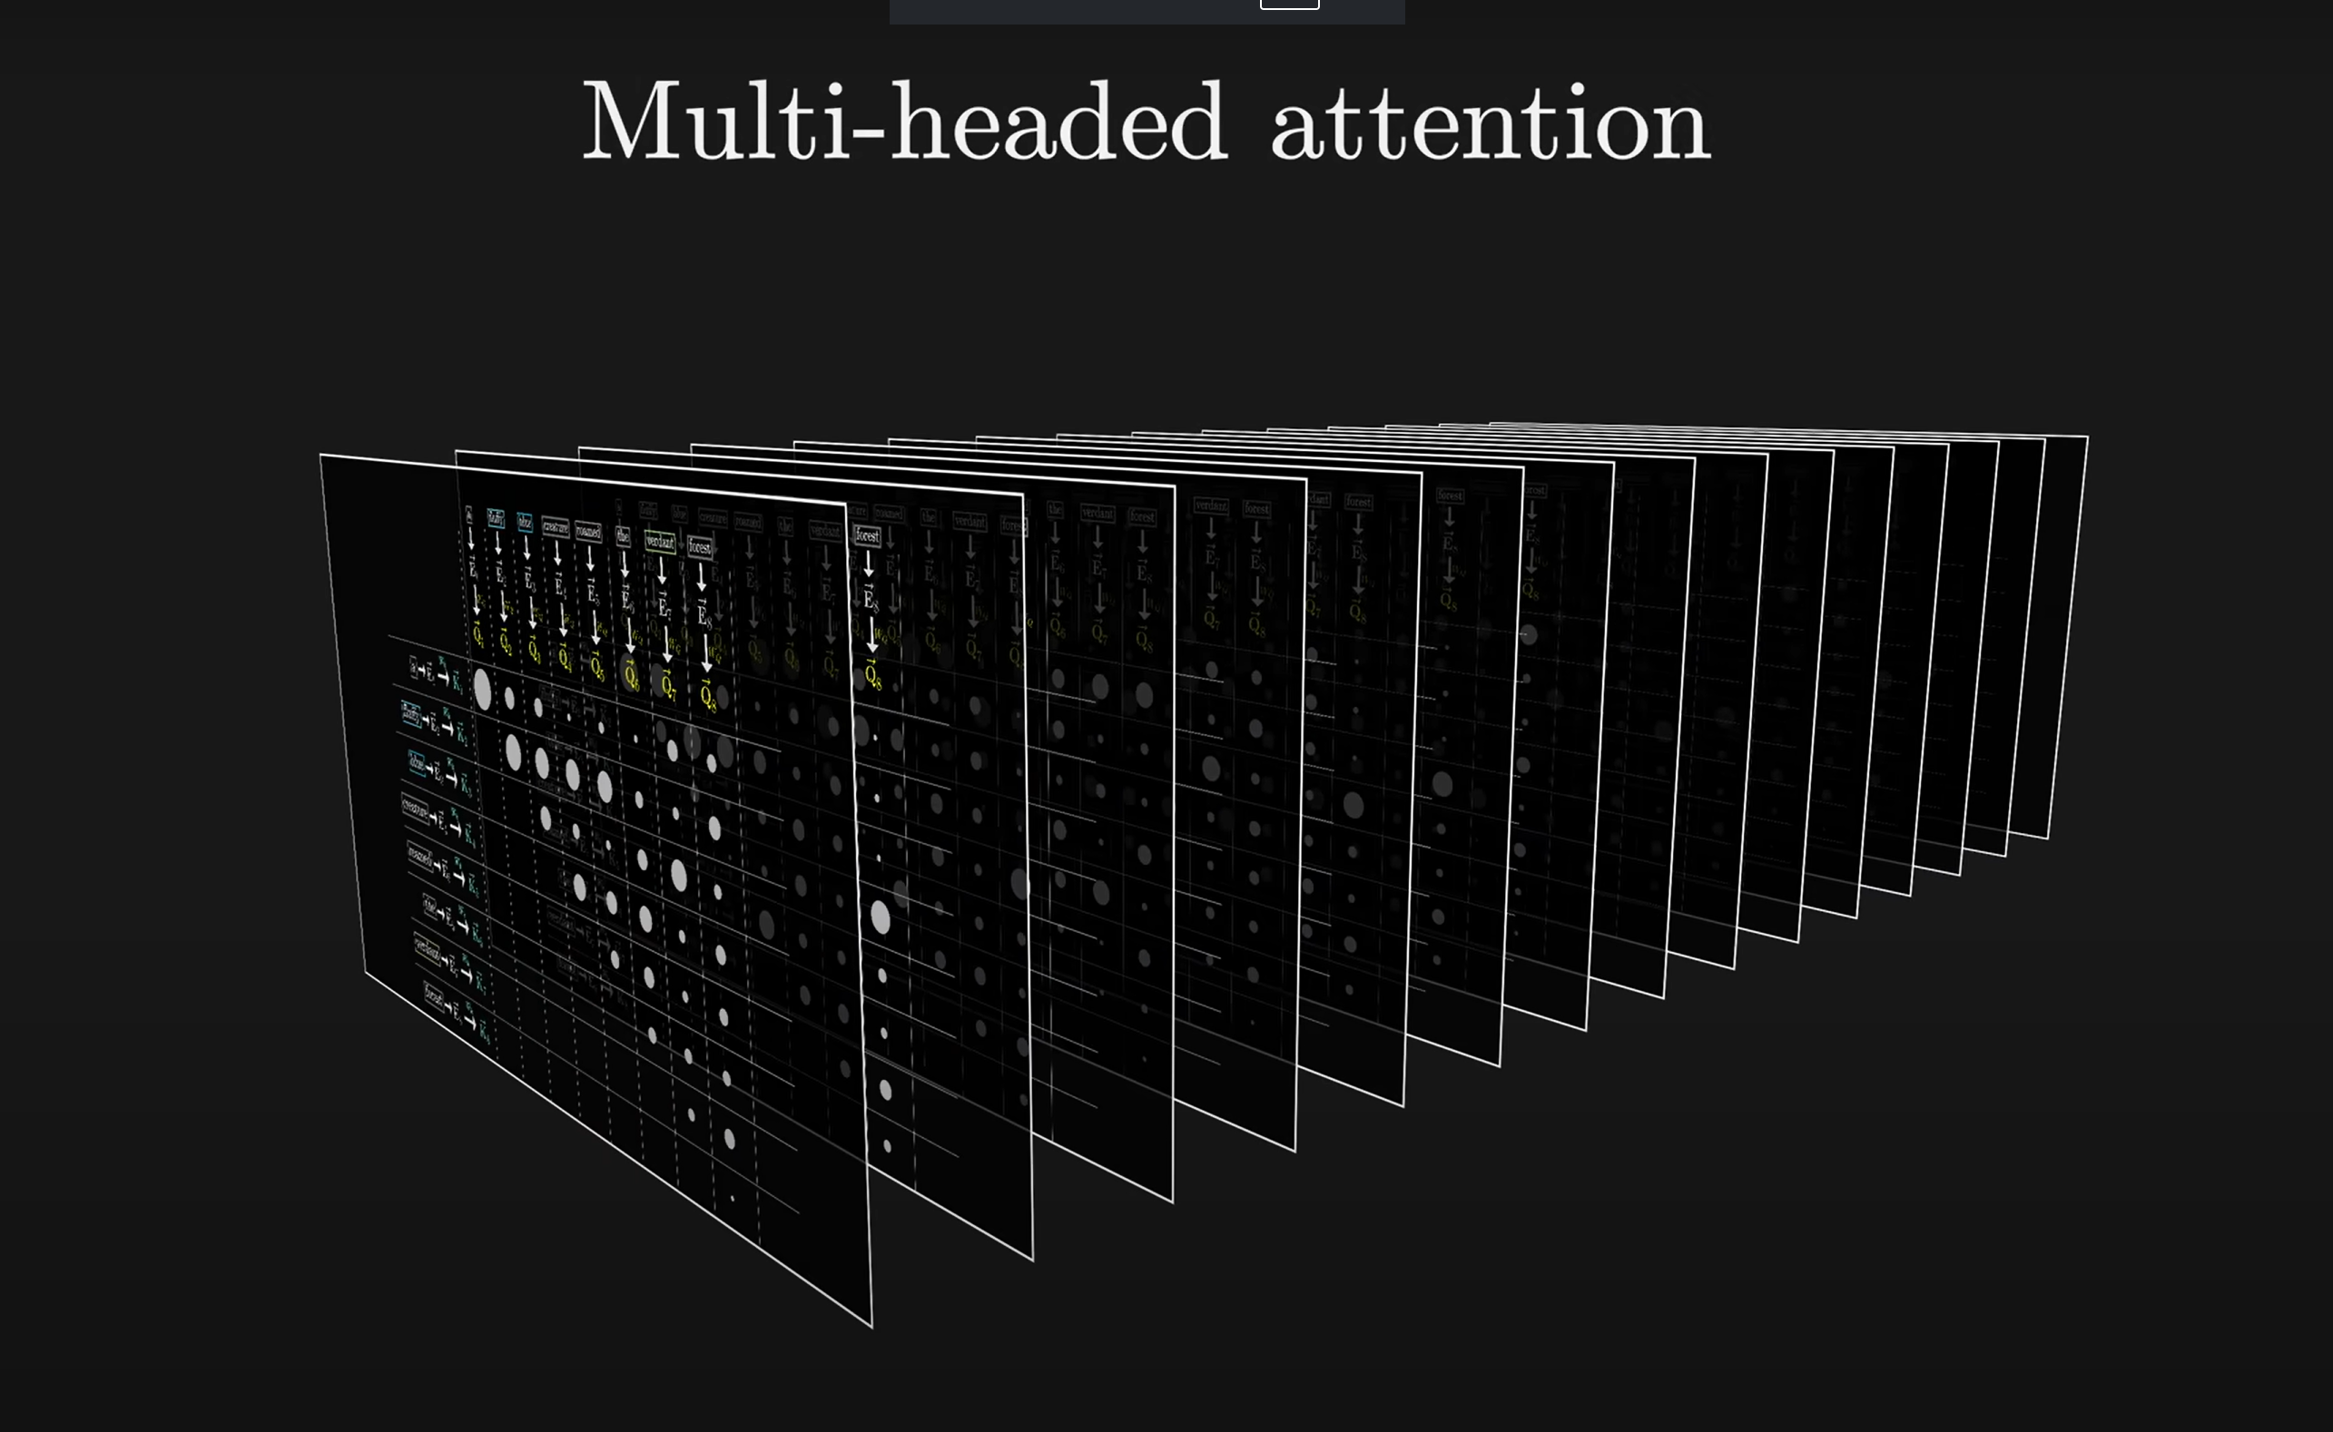

Slide 15
Attention head
The transformer architecture consists of multiple layers of (multi-)attention heads.
Each one allowed to learn increasingly complex and long-distance token embeddings.
Information flows from left to right (autoregressive).
Machine Learning Methods for Biomedical Data (D012554)

Slide 16
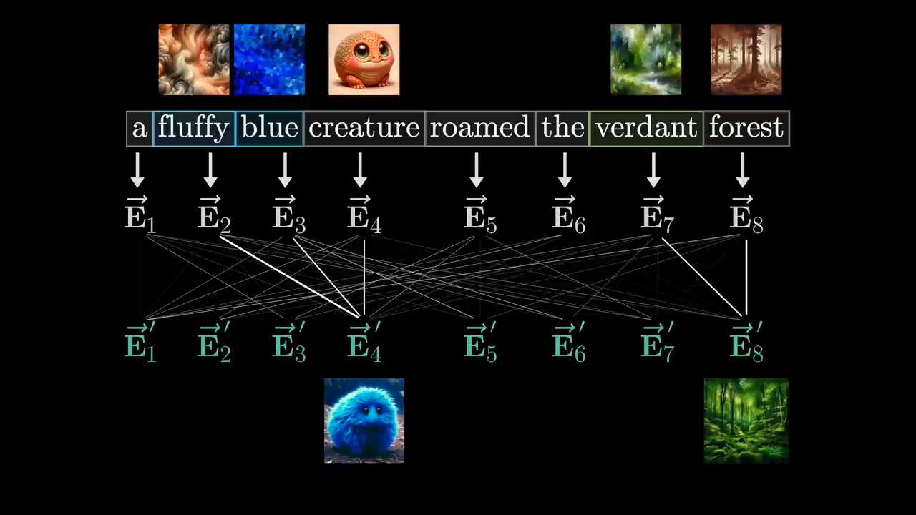

Slide 17
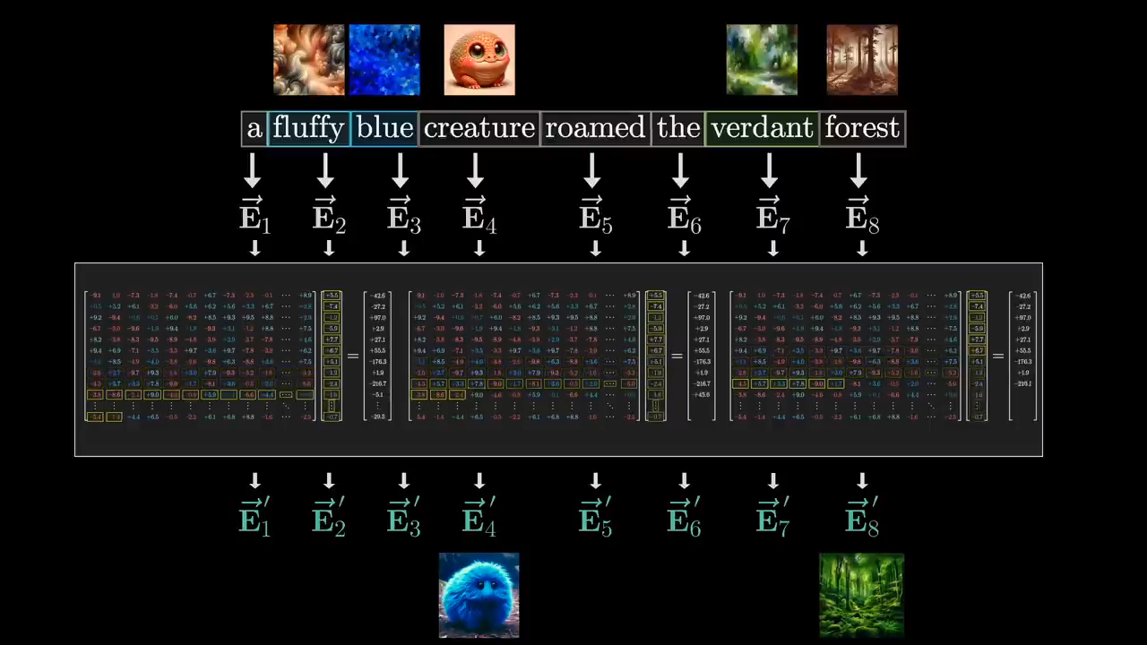

Slide 18
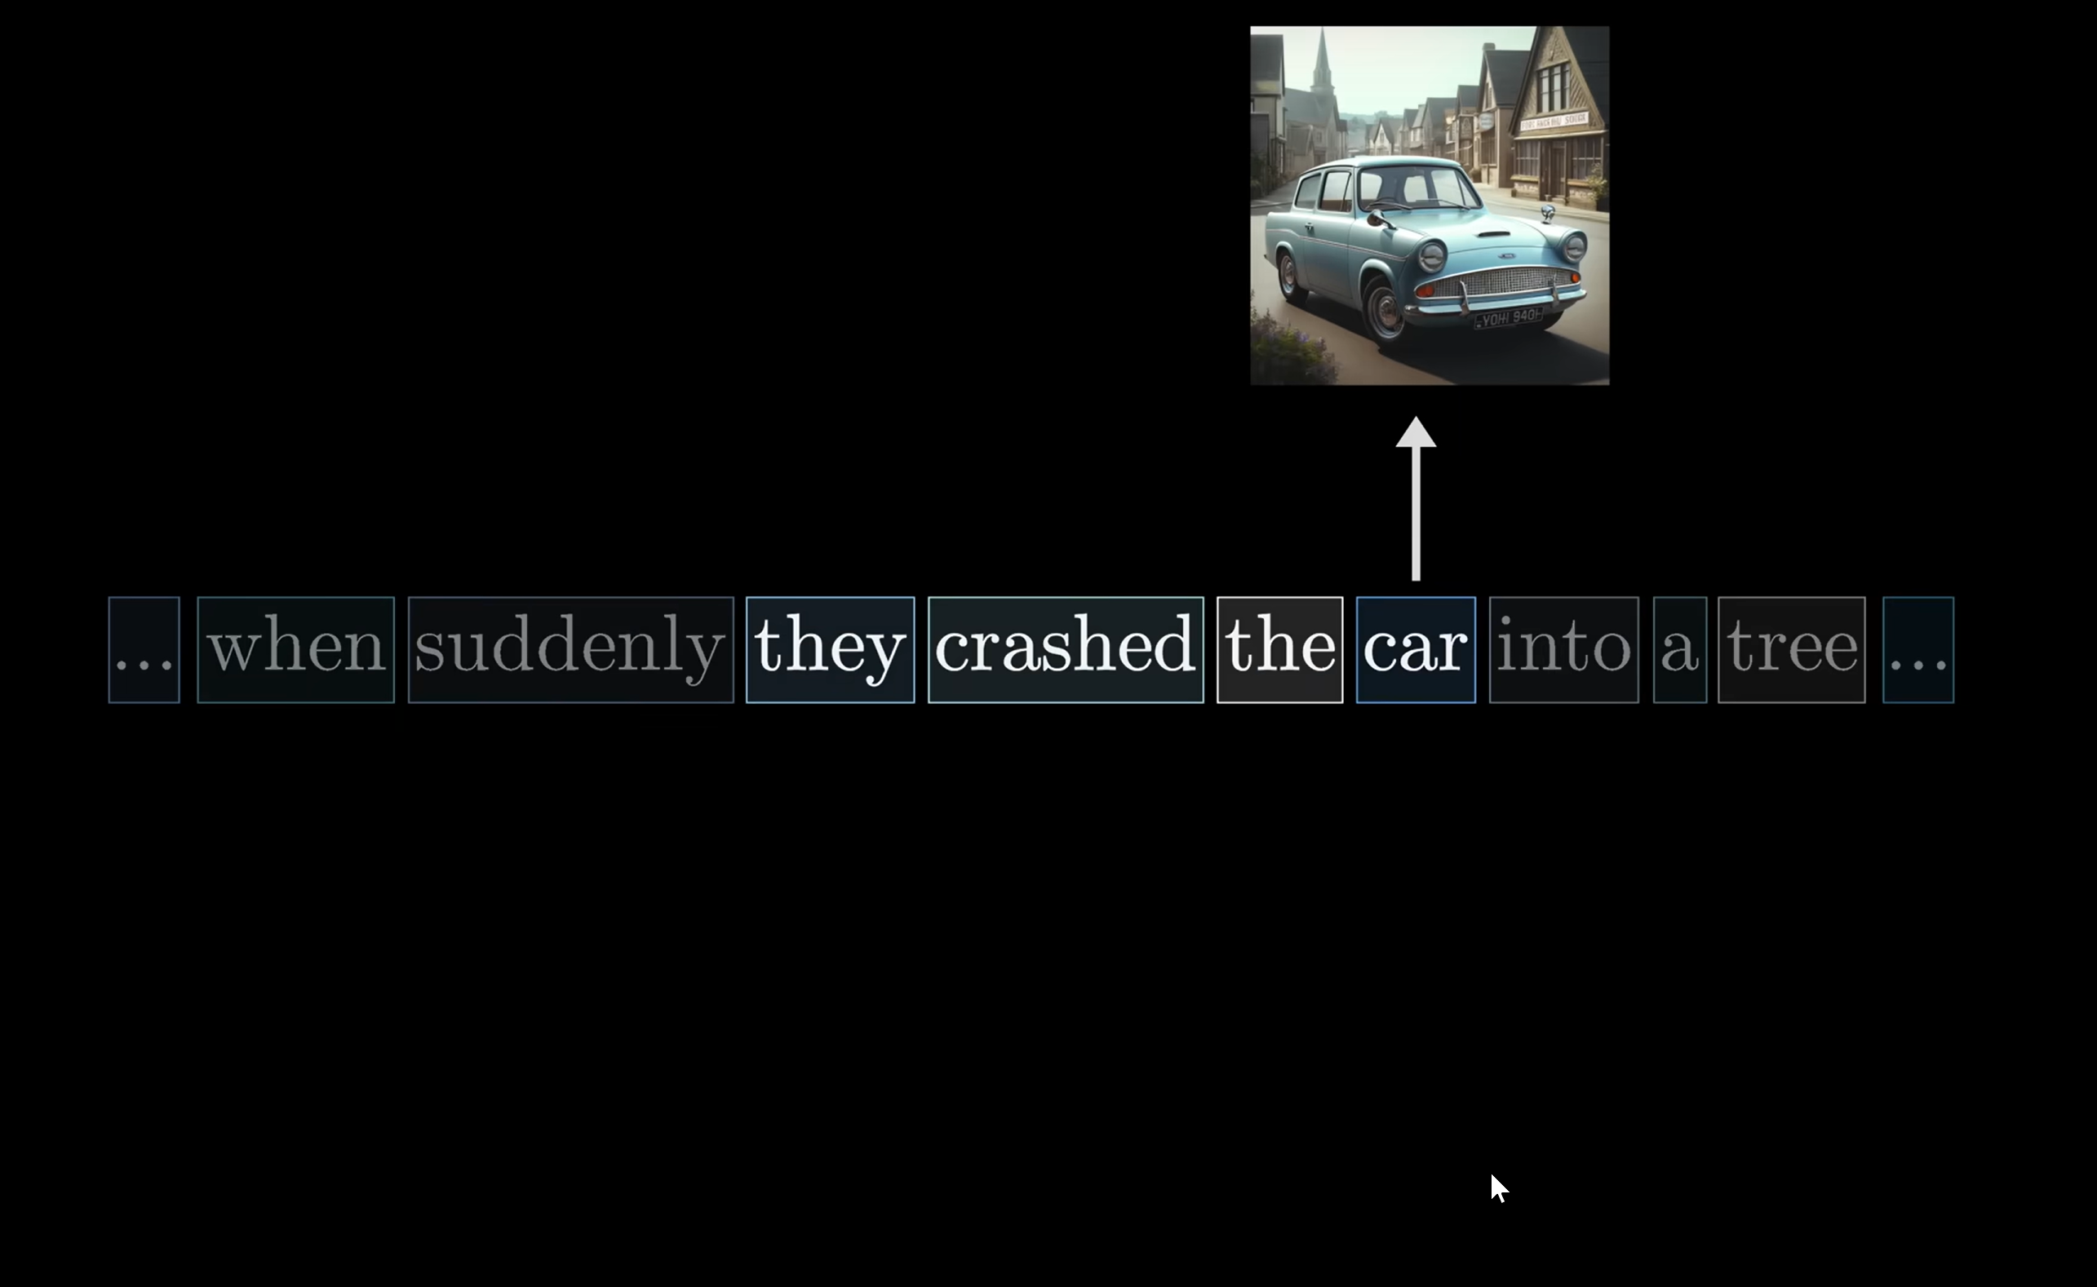

Slide 19
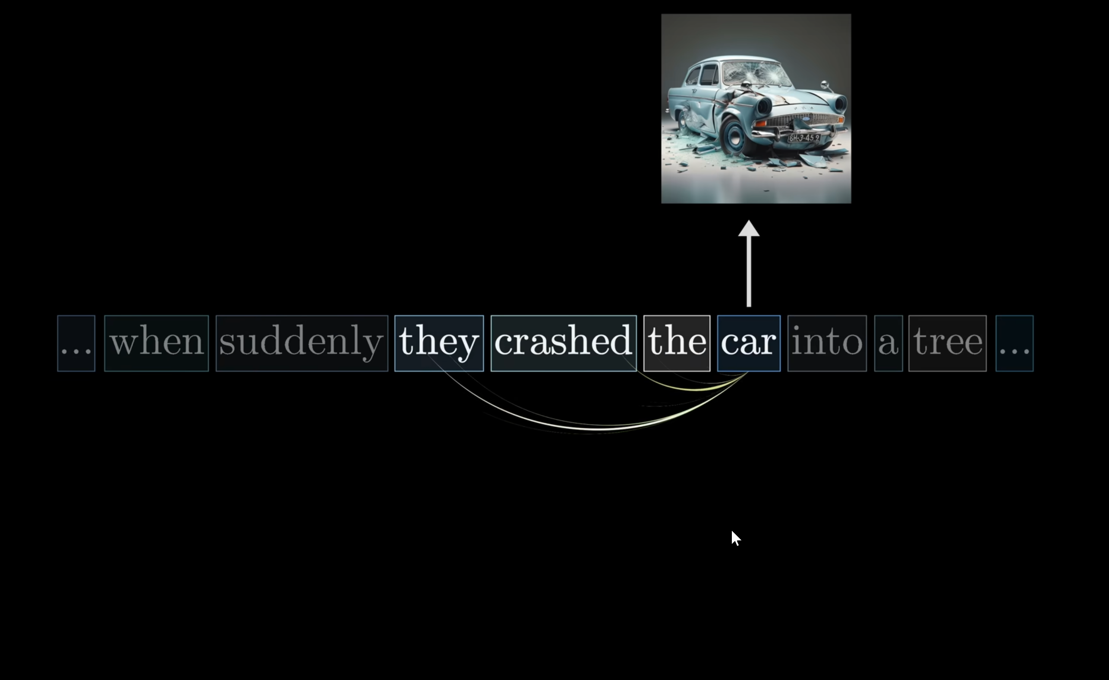

Slide 20
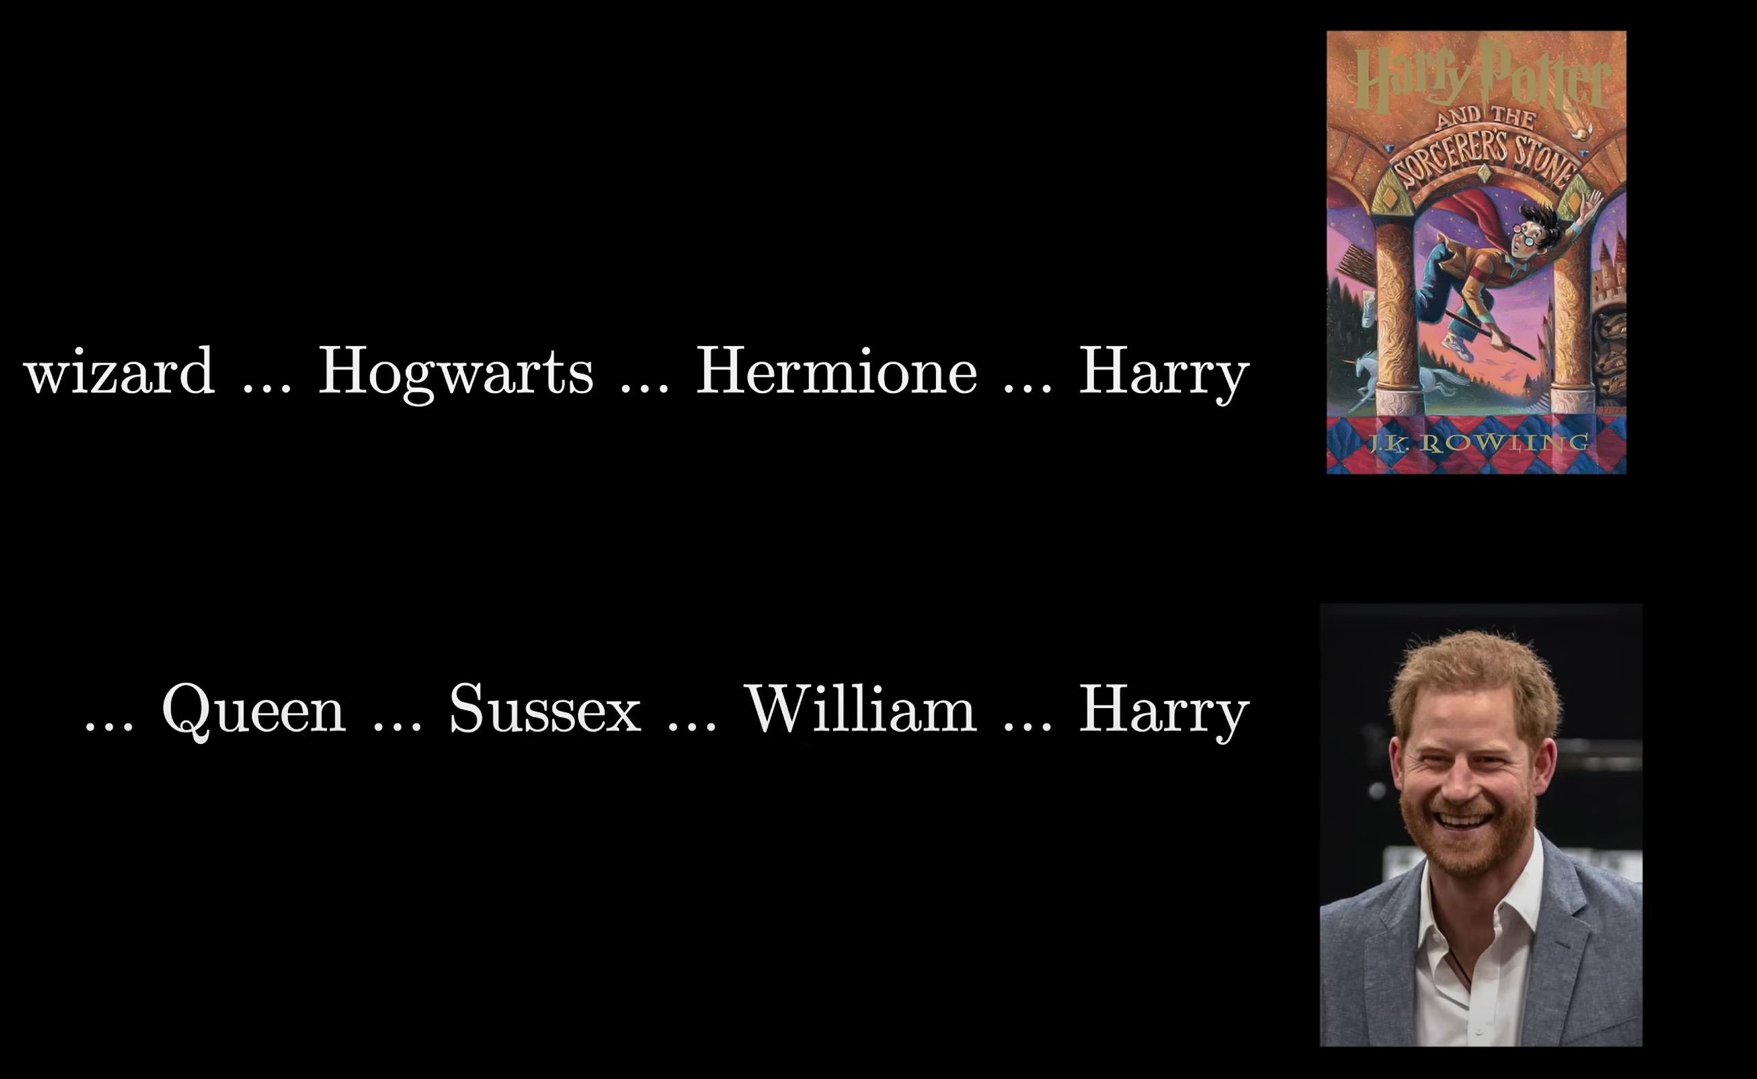

Slide 21
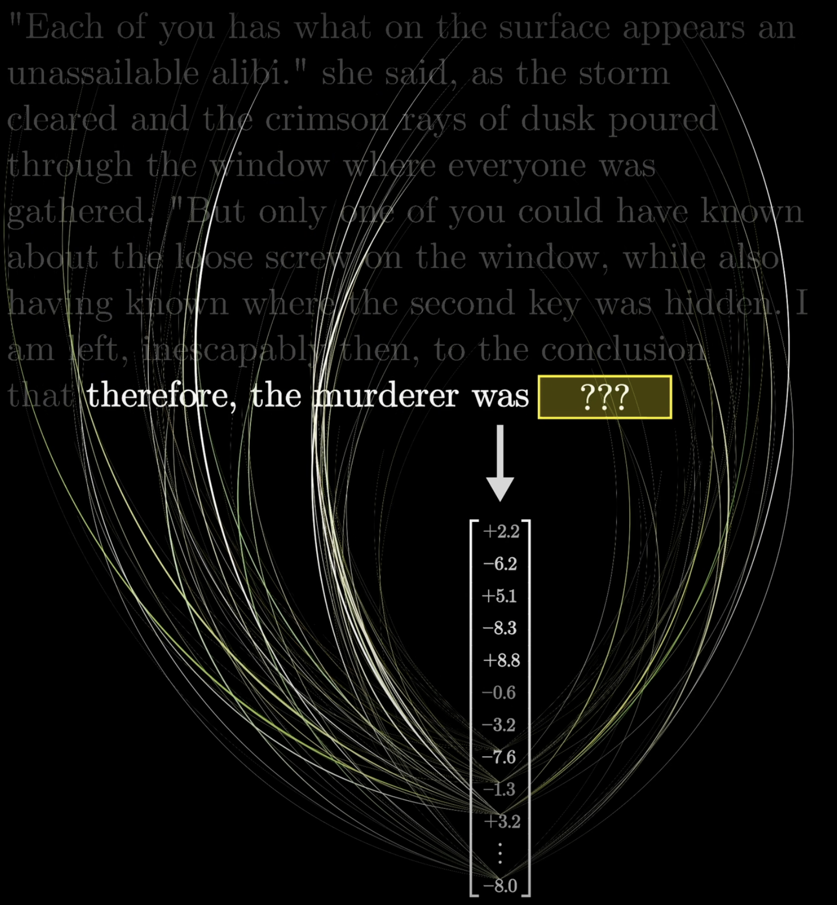
Attention head
The transformer architecture consists of multiple layers of (multi-)attention heads.
Each one allowed to learn increasingly complex and long-distance token embeddings.
All token embeddings (first layer) are processed through all the attention layers and enriched with all relevant information in the context window.
The final embedding of the last token then contains all information required to predict the next token.
Machine Learning Methods for Biomedical Data (D012554)

Slide 22
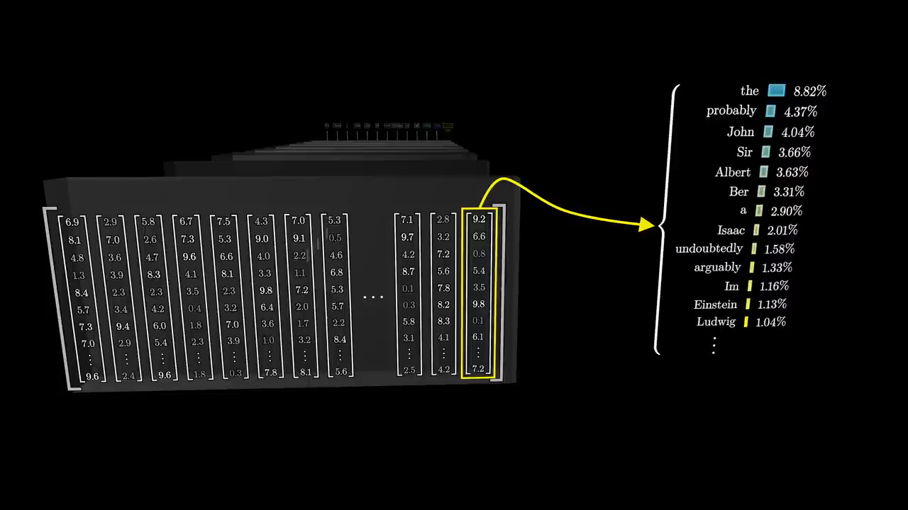

Slide 23
Attention head
Query (Q), Key (K), and Value (V) Matrices: These are the three essential components in an attention mechanism, derived from the input embeddings through learned weight matrices.
Query (Q): Represents what the current token is searching for in other tokens, helping determine relevance in context.
Key (K): Encodes the characteristics of each token, allowing it to be compared against queries to compute attention scores.
Value (V): Contains the actual information of each token, weighted by the attention scores before being aggregated into the final output.
Machine Learning Methods for Biomedical Data (D012554)

Slide 24

Attention head modelparameters
jalammar.github.io/illustrated-transformer/
Machine Learning Methods for Biomedical Data (D012554)

Slide 25
Attention head
Q (Query), K (Key), and V (Value) matrices are learned linear transformations applied to input embeddings, enabling the model to project inputs into different representational subspaces.
AThe Q and K matrices are used to compute attention scores via dot products, which are then normalized (typically with softmax) to determine the relevance of each token to others.
The attention scores are used to weight the V (Value) matrix, aggregating relevant information from other tokens to form a context-aware representation.
Together, these matrices enable the self-attention mechanism in transformer architectures, allowing the model to capture and utilize dependencies between tokens regardless of their distance in the sequence.
Machine Learning Methods for Biomedical Data (D012554)

Slide 26
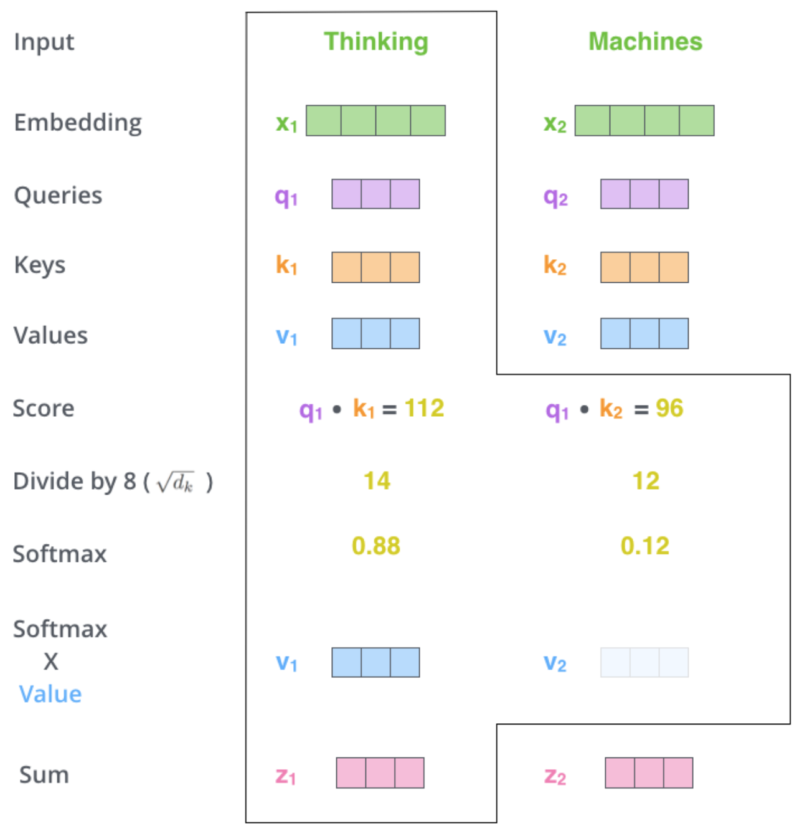
Attention head flow
jalammar.github.io/illustrated-transformer/
Machine Learning Methods for Biomedical Data (D012554)

Slide 27
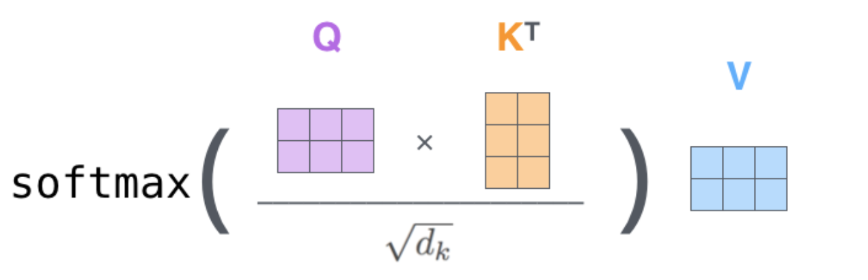
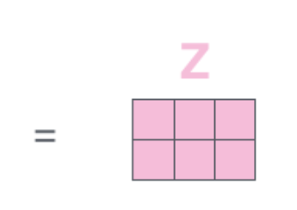
Attention head flow
jalammar.github.io/illustrated-transformer/
Machine Learning Methods for Biomedical Data (D012554)

Slide 28
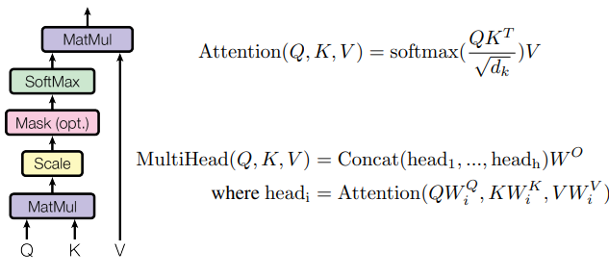
Attention head flow
Ashish Vaswani et al., Attention is all you need. (NIPS'17)
Machine Learning Methods for Biomedical Data (D012554)

Slide 29
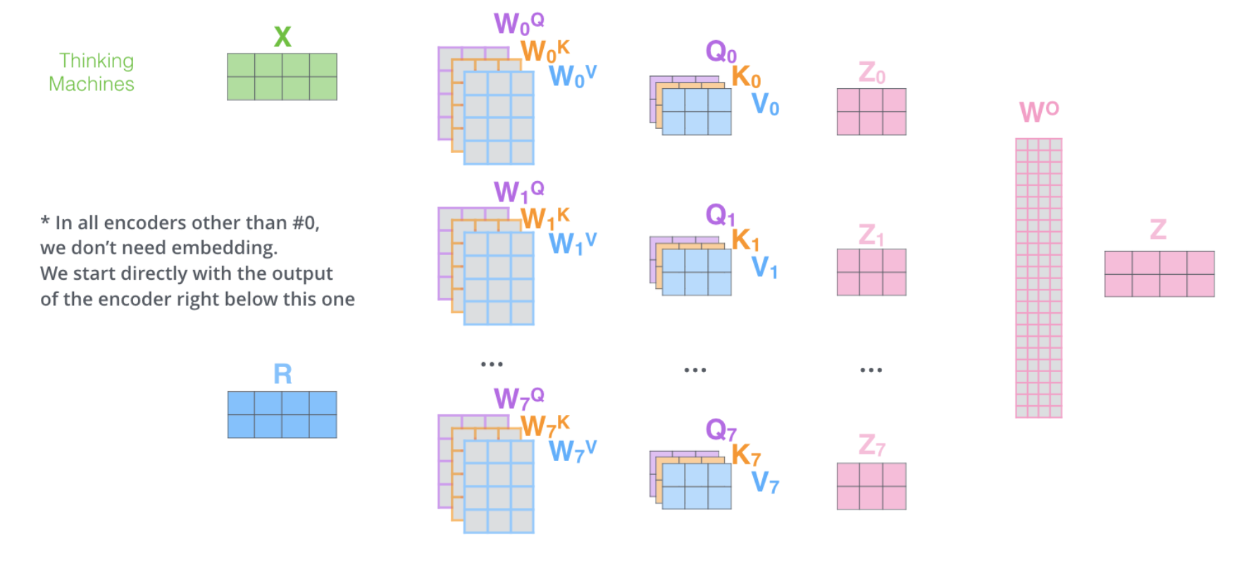
Multi attention flow
jalammar.github.io/illustrated-transformer/
Machine Learning Methods for Biomedical Data (D012554)

Slide 30
Notes:
Remember this slide, lets start from here. Suppose we are indeed enriching embeddings with adjectives.
The matrices I did not explain previously are the Q,K,V matrices.

Slide 31
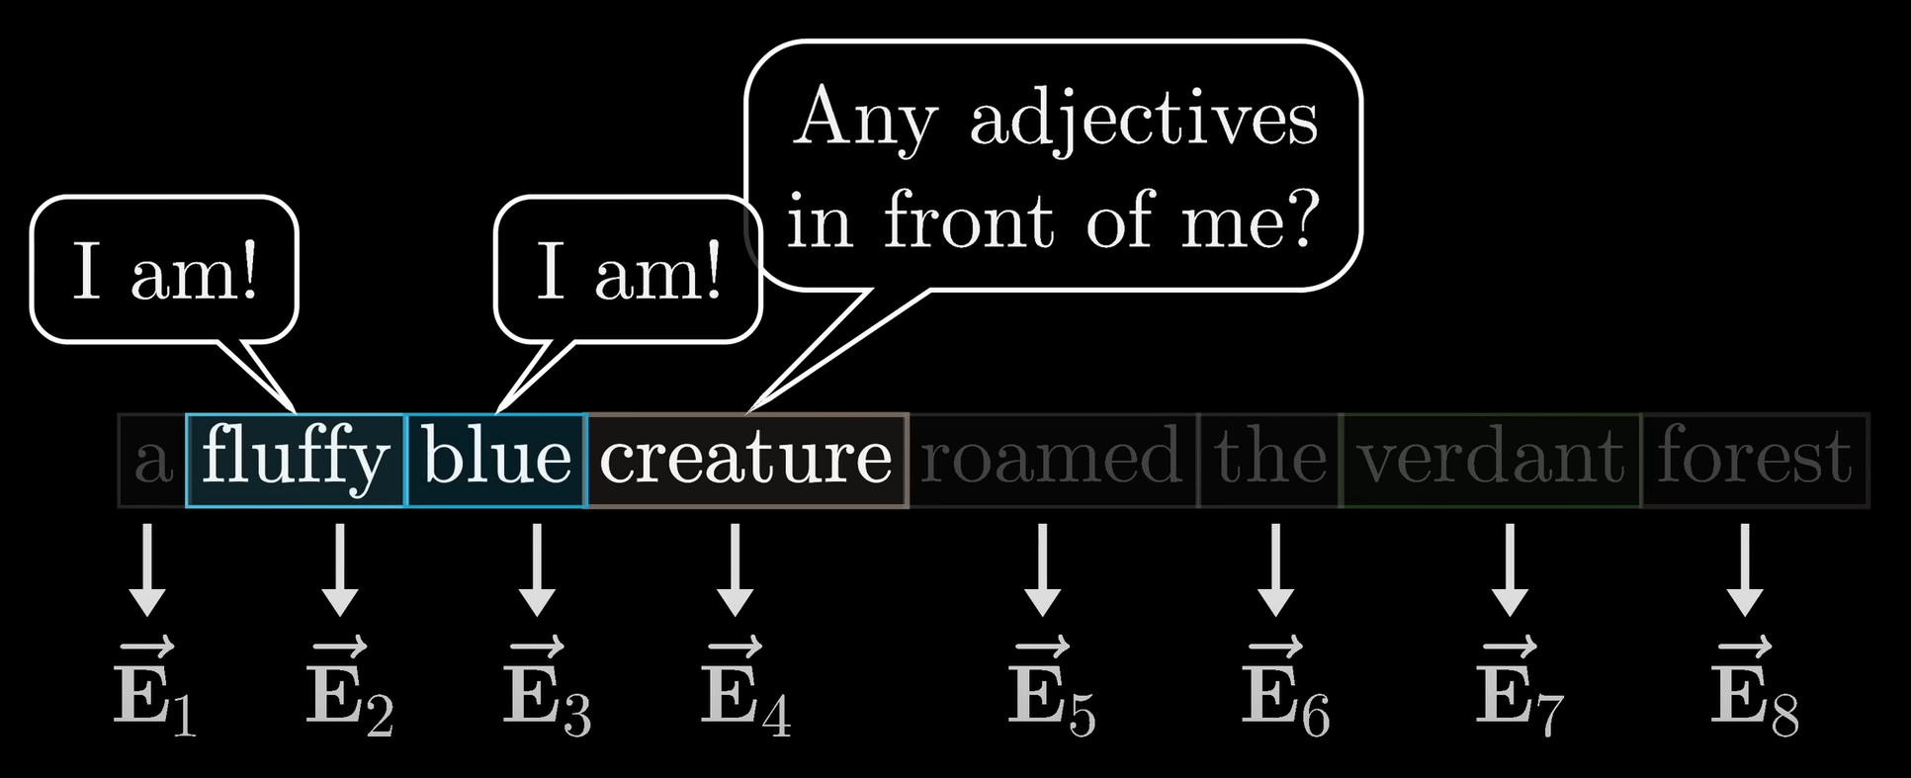
Attention head
We can at the query as asking a question and the key as an answer.
Machine Learning Methods for Biomedical Data (D012554)

Slide 32
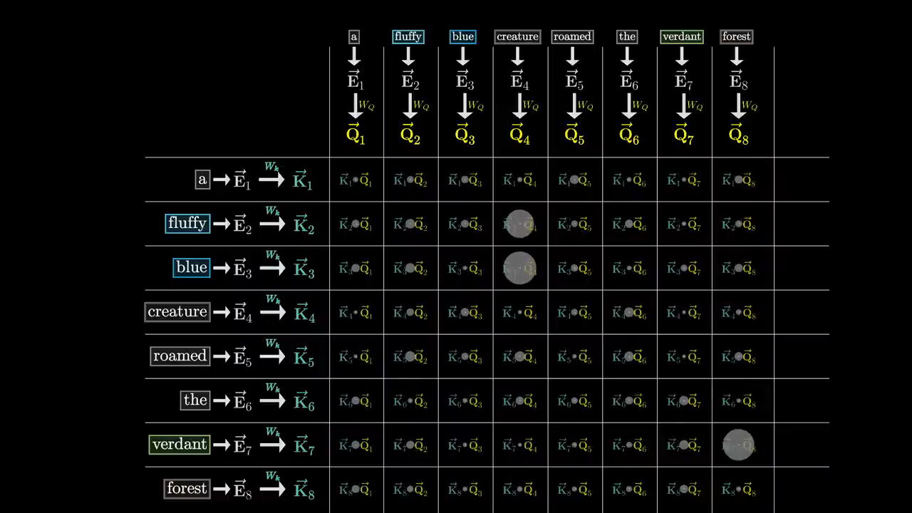
Notes:
The reason why this attention head is producing these attentions is bacouse it focuses on adjectives.

Slide 33
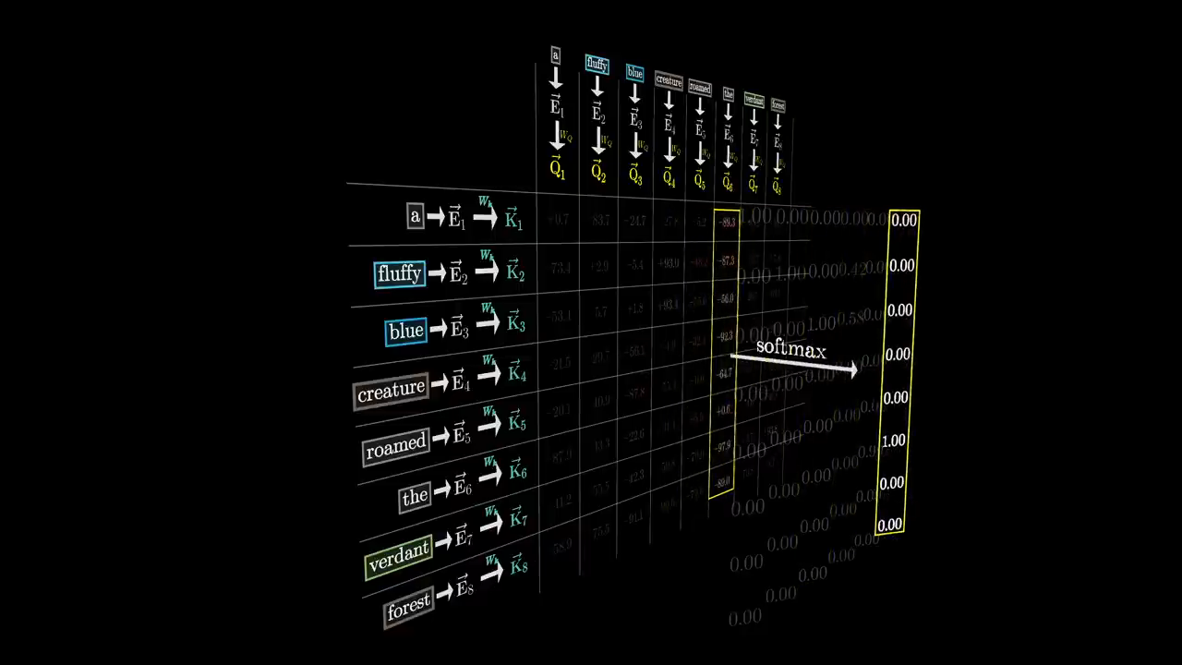

Slide 34
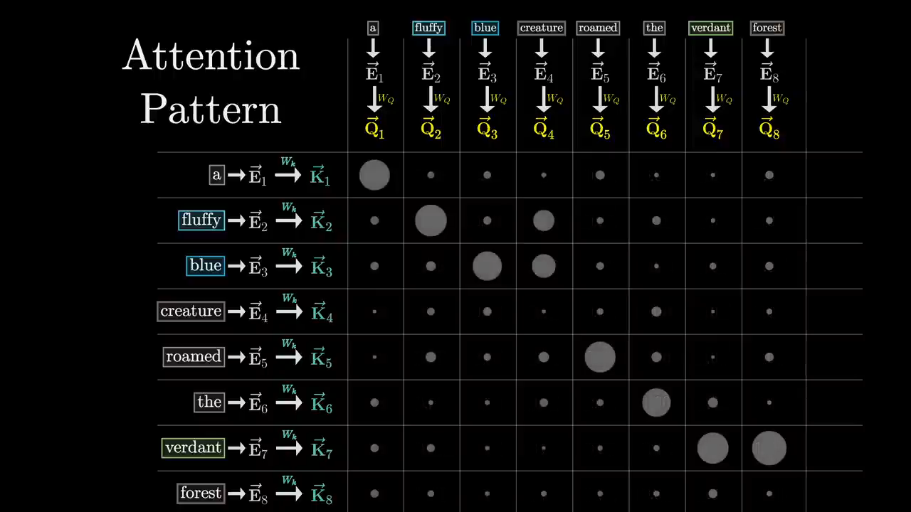

Slide 35
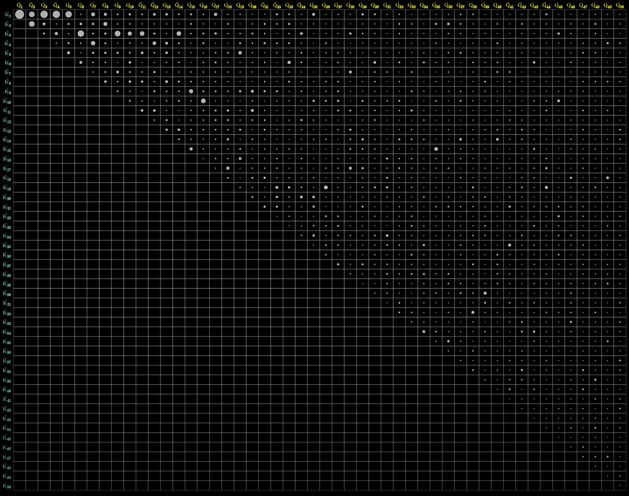

Slide 36
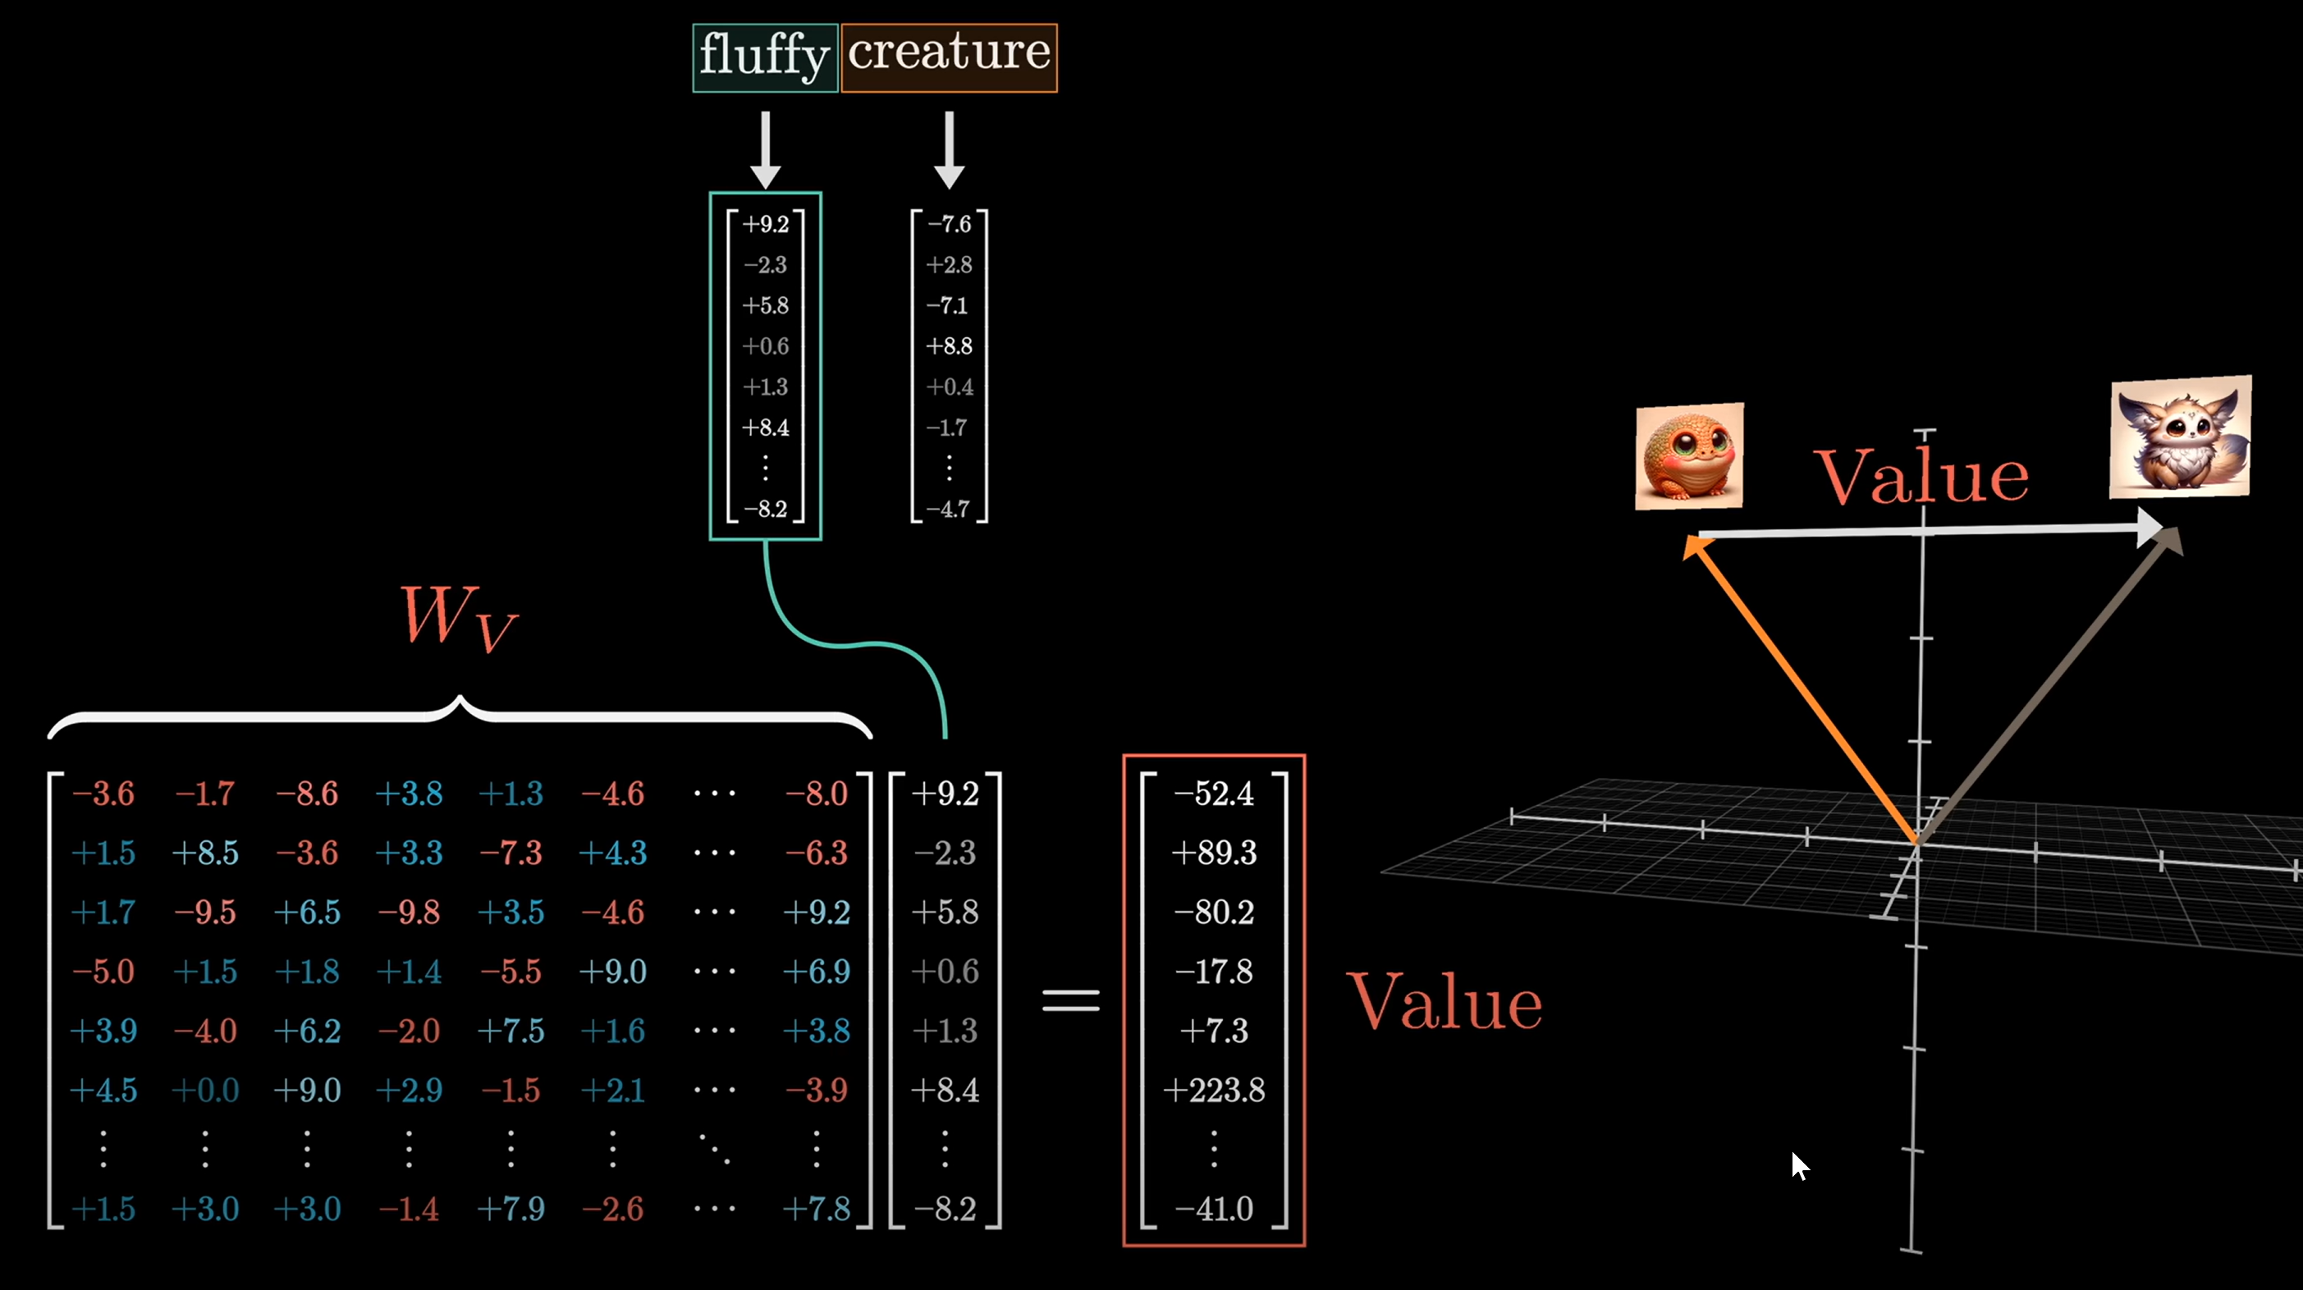

Slide 37
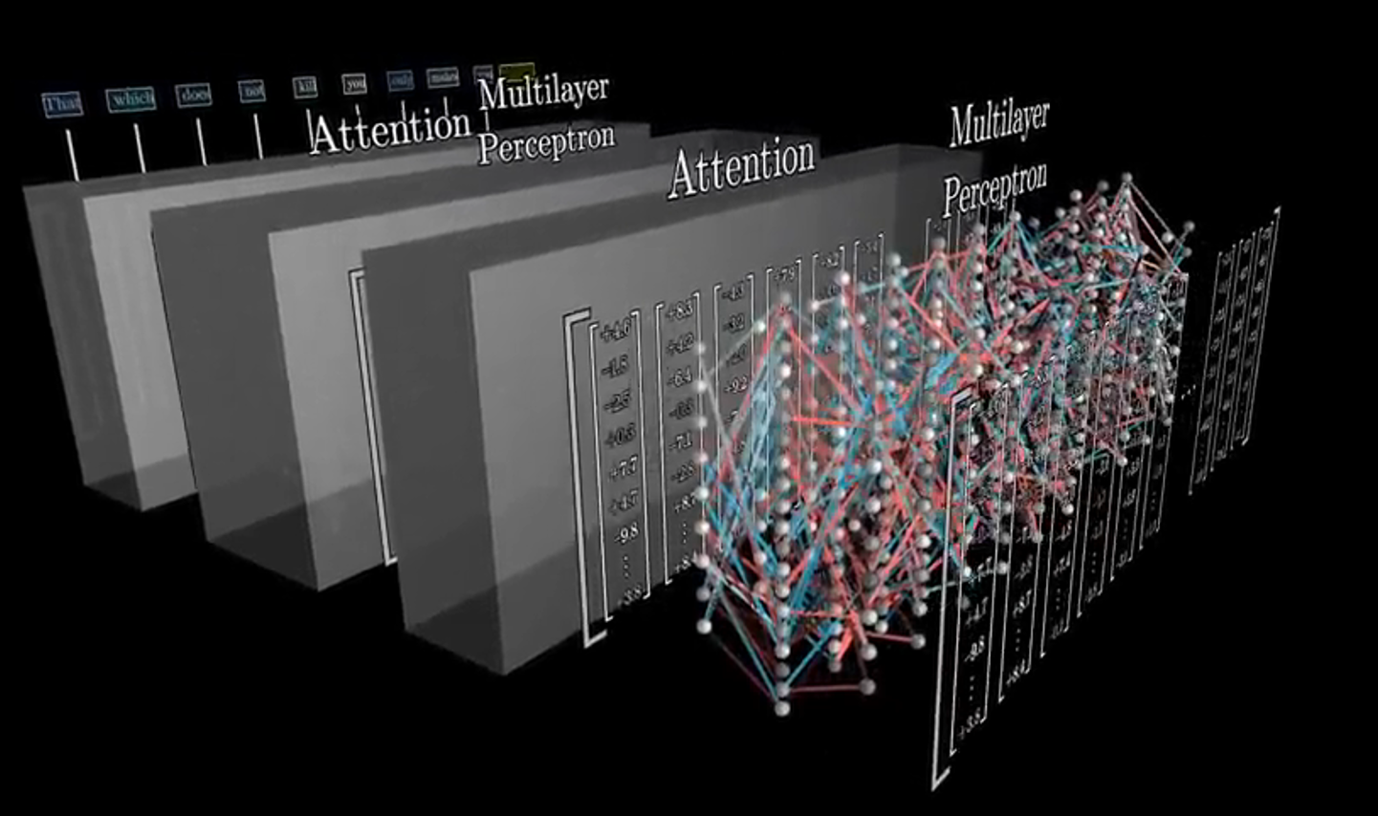
MLP (Feedforward) Layers in the Transformer
Each Transformer layer contains an MLP (Multi-Layer Perceptron), applied independently to each token after attention.
Machine Learning Methods for Biomedical Data (D012554)

Slide 38
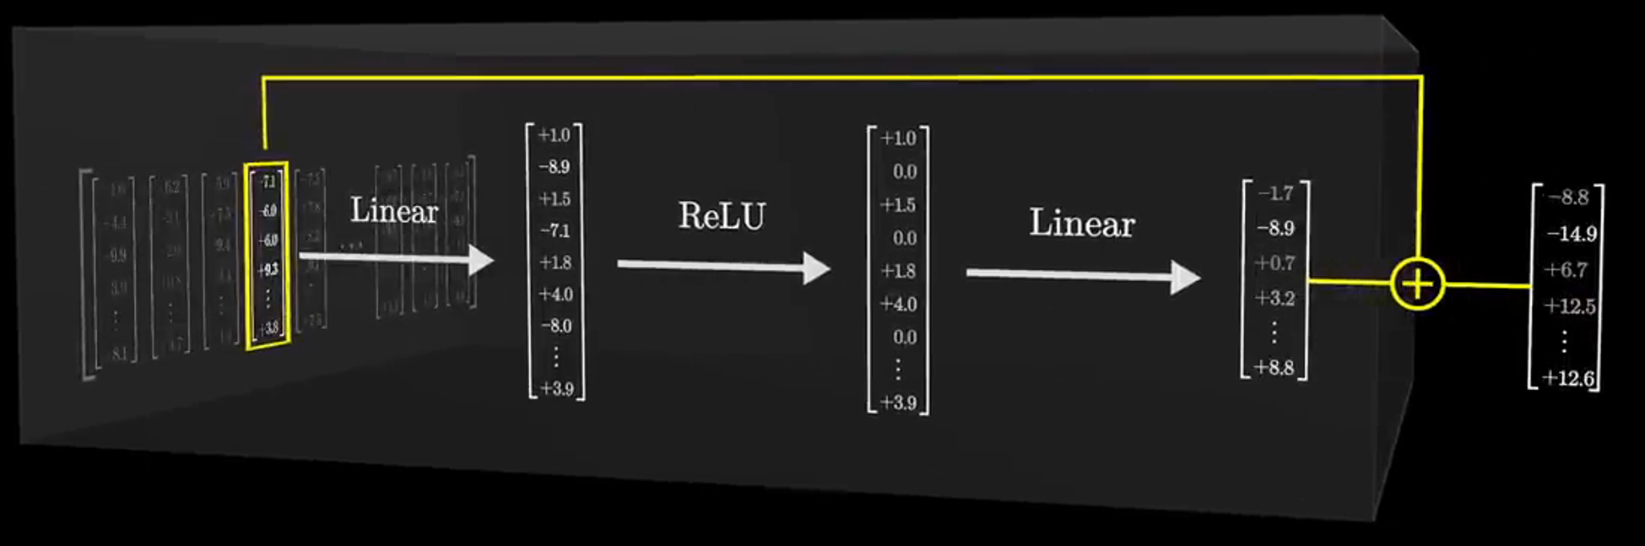
MLP (Feedforward) Layers in the Transformer
Each Transformer layer contains an MLP (Multi-Layer Perceptron), applied independently to each token after attention.
It consists of two fully connected (dense) layers with a non-linearity in between.
Machine Learning Methods for Biomedical Data (D012554)

Slide 39
MLP (Feedforward) Layers in the Transformer
Each Transformer layer contains an MLP (Multi-Layer Perceptron), applied independently to each token after attention.
It consists of two fully connected (dense) layers with a non-linearity in between.
The same MLP applies to each token independently.
First results indicate the these MLPs allow the model to ‘remember facts’.
Machine Learning Methods for Biomedical Data (D012554)

Slide 40
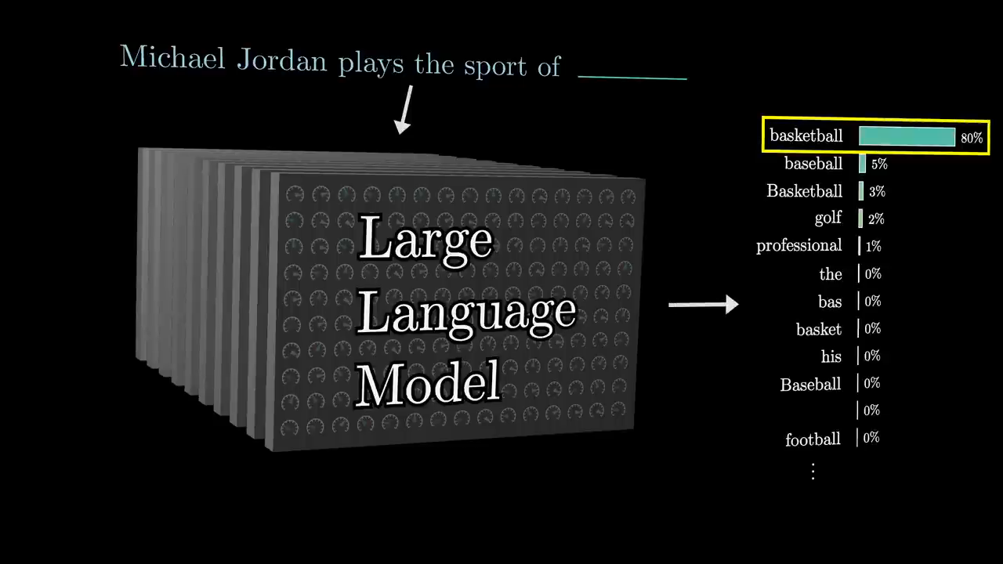

Slide 41
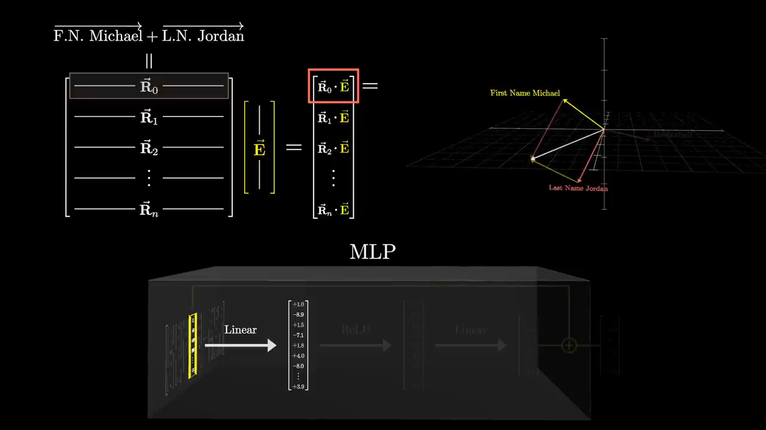
Notes:
Is an embedding vector that represents something with first name Michael and last name Jordan?
If so The neuron in the red square will fire (be activated, positive value).

Slide 42
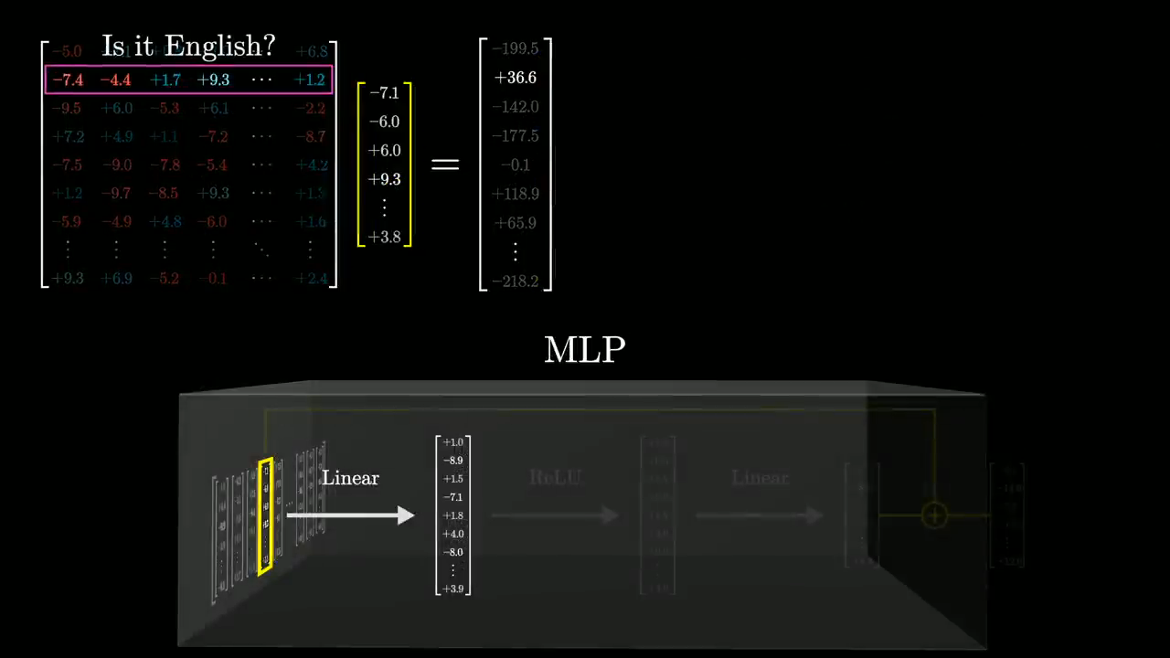

Slide 43
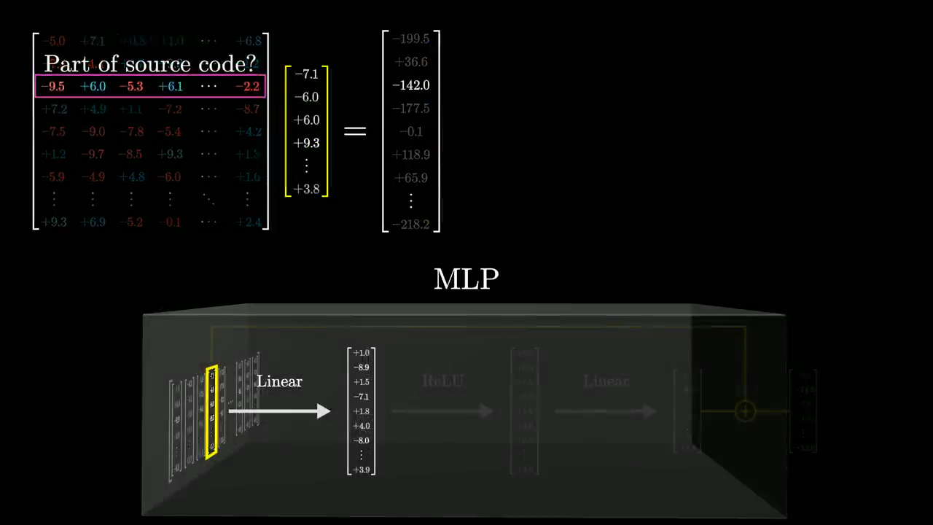

Slide 44
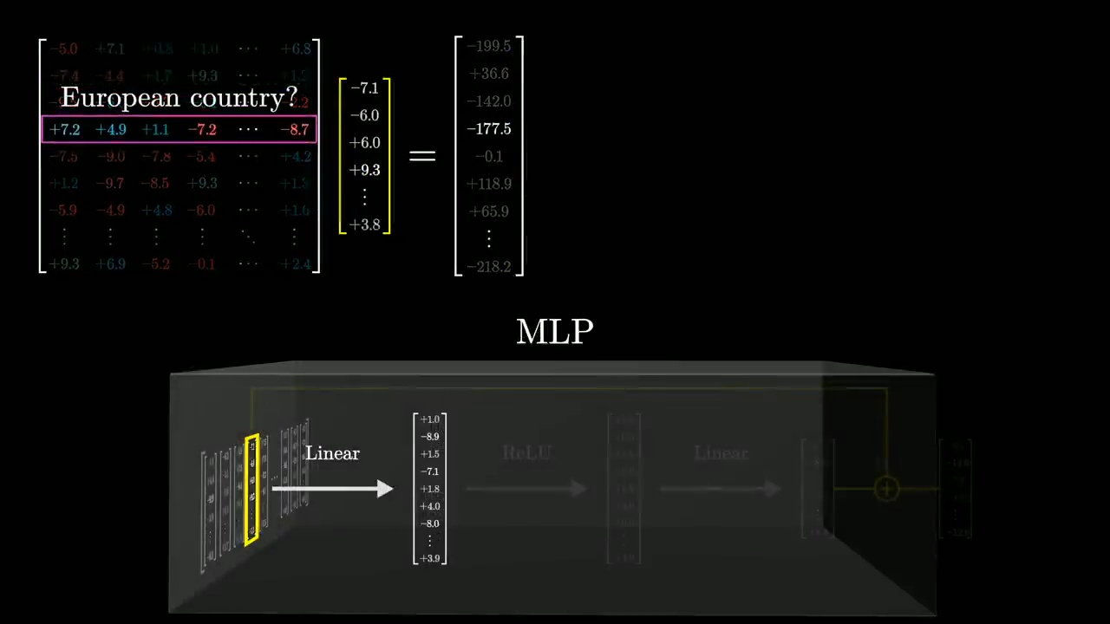

Slide 45
MLP (Feedforward) Layers in the Transformer
If the entry that we're measuring is high for Michael Jordan, it would also be somewhat triggered by Michael Phelps or Alexis Jordan, despite those being unrelated conceptually.
The non-linear transformation layer (ReLU) solves this by turning it more into a yes or no question.
Machine Learning Methods for Biomedical Data (D012554)

Slide 46
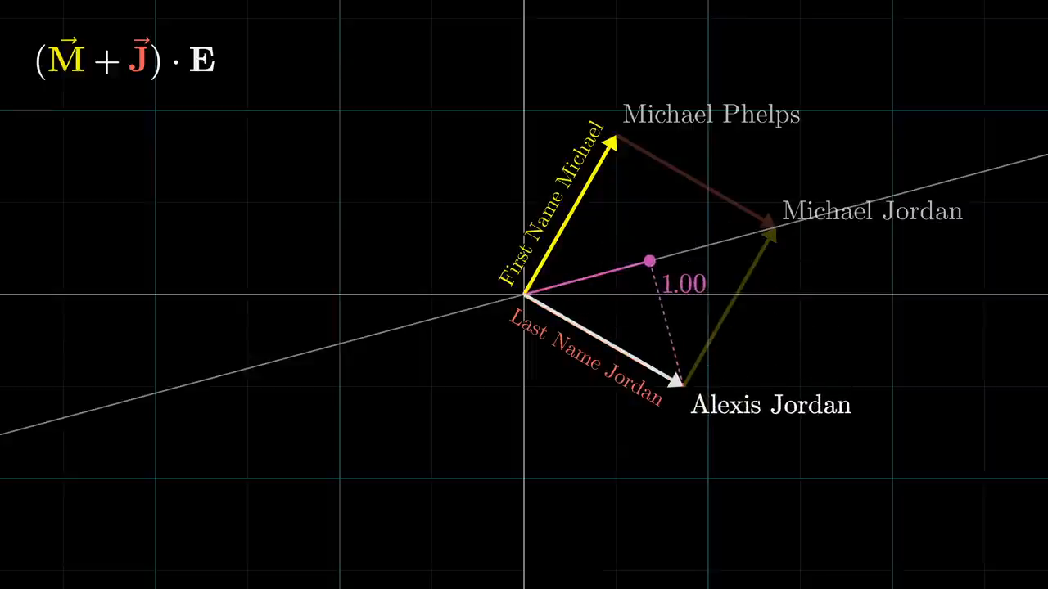

Slide 47
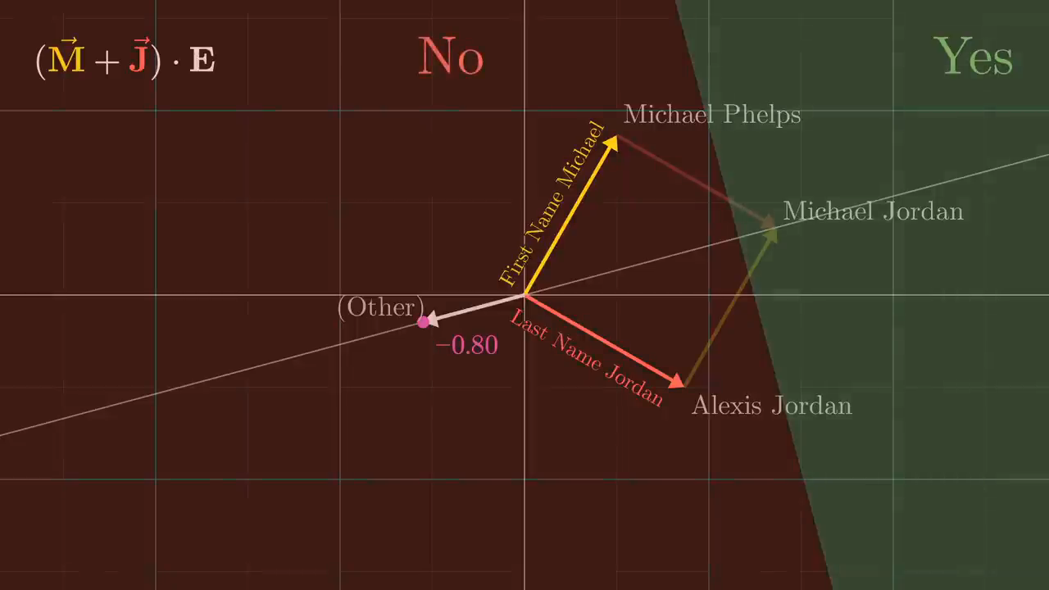

Slide 48
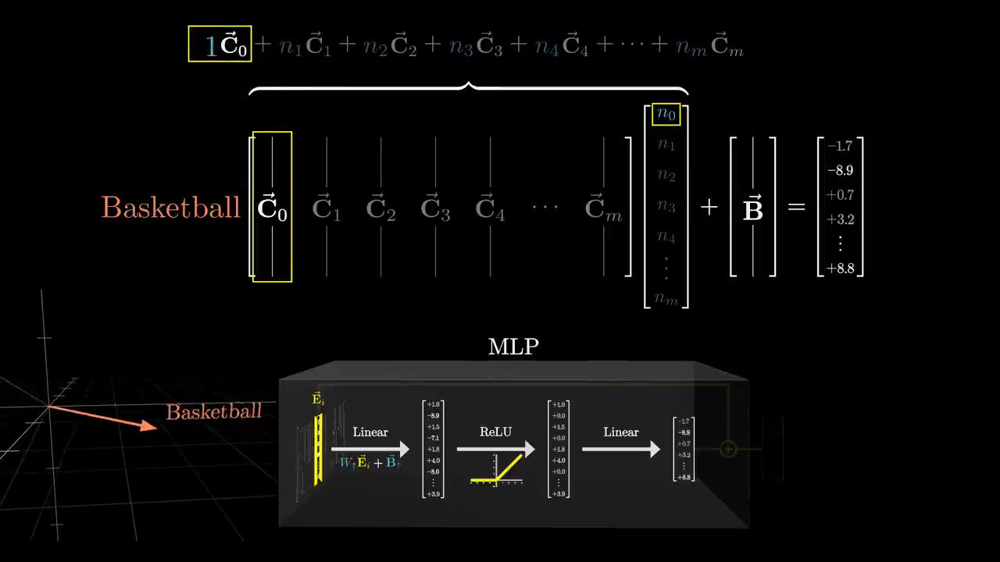

Slide 49
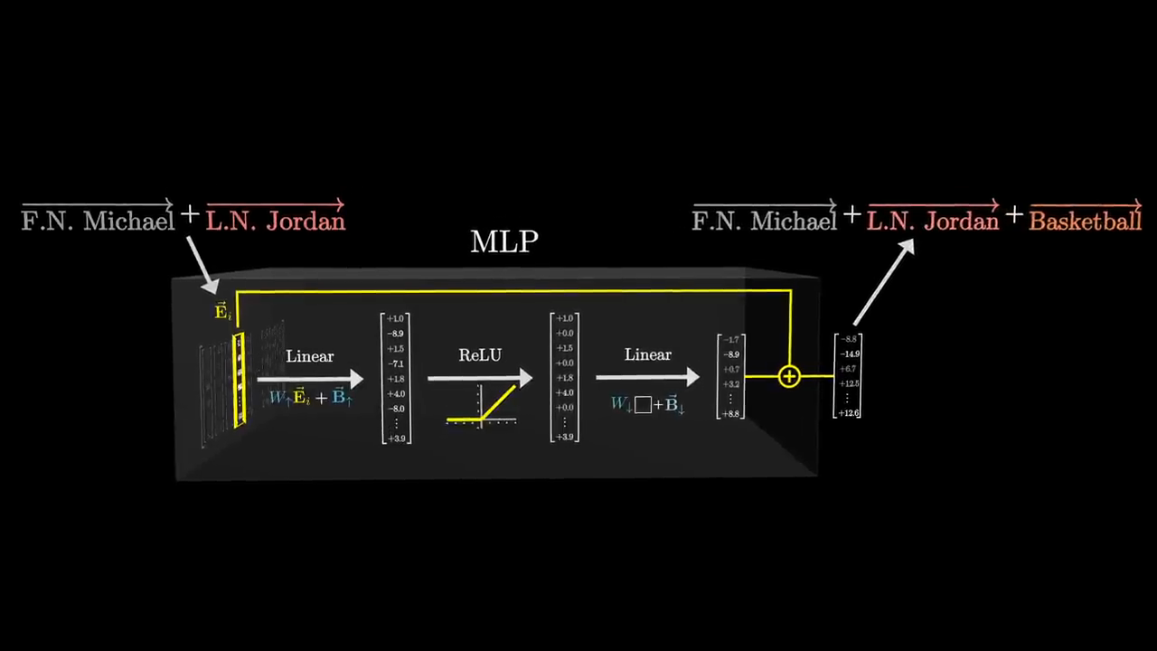

Slide 50
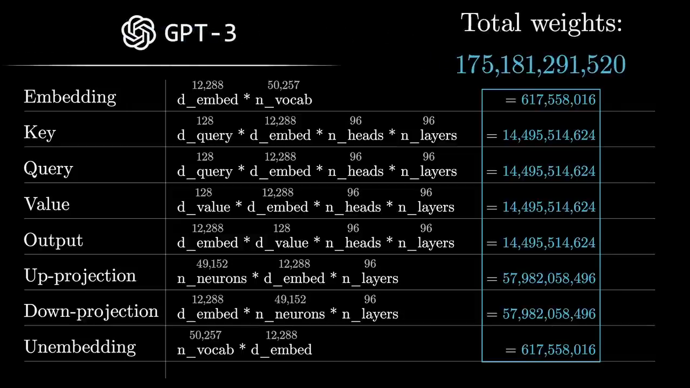

Slide 51

GTP-2
GPT_text_generation.ipynb
Machine Learning Methods for Biomedical Data (D012554)

Slide 52
Data: Common Crawl
Common Crawl is an open repository of web crawl data that contains petabytes of information extracted from billions of web pages dating back to 2008.
The dataset is freely available for anyone to download and use, making it a valuable resource for researchers, businesses, and developers working on natural language processing, machine learning, and web analysis projects.
As of late 2024, the Common Crawl corpus contained over 250 billion web pages, with the entire archive consuming hundreds of petabytes of storage space.
Each monthly crawl typically contains 200-300 terabytes of data, representing billions of individual web pages from tens of millions of domains.
The dataset includes content in hundreds of languages, though English content historically makes up approximately 40-50% of the corpus.

Slide 53
Chat bots
https://poloclub.github.io/transformer-explainer/
openAI
Machine Learning Methods for Biomedical Data (D012554)

Slide 54
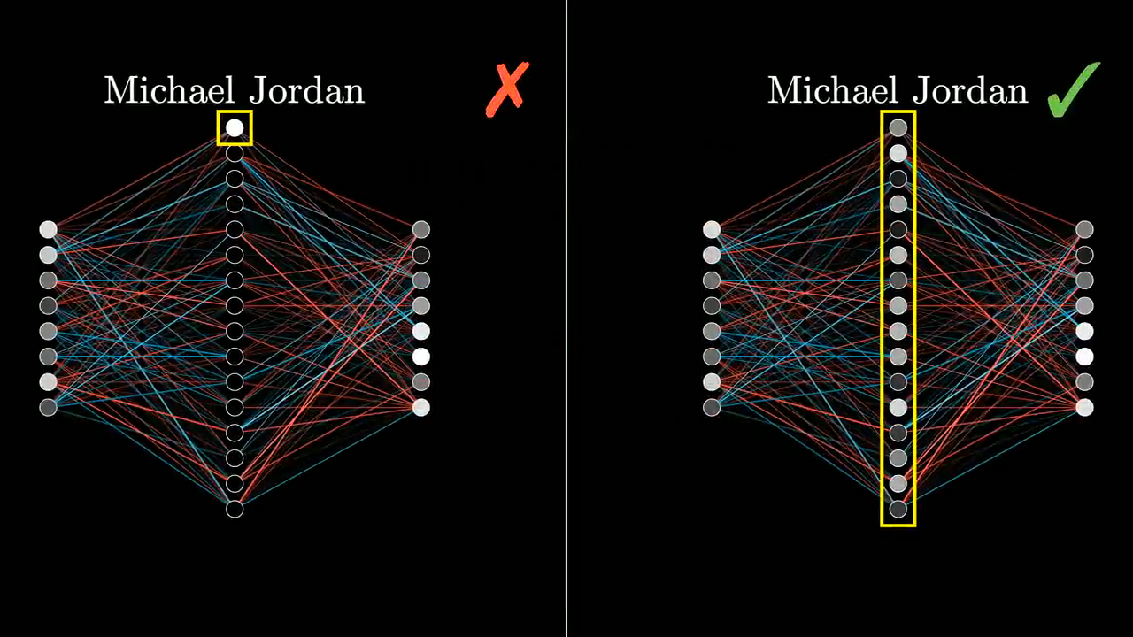
Superposition
Neural networks store multiple features in overlapping directions within their weight space, rather than dedicating separate neurons to each feature.
This allows a network to encode more features than the number of neurons, similar to how quantum superposition allows multiple states to exist simultaneously.

Slide 55
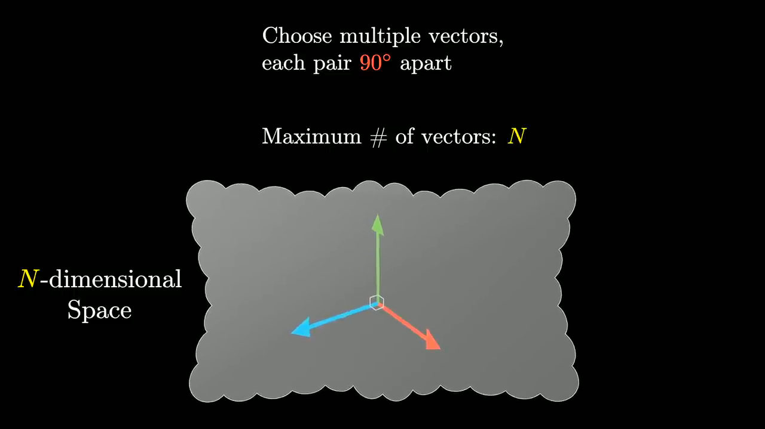

Slide 56
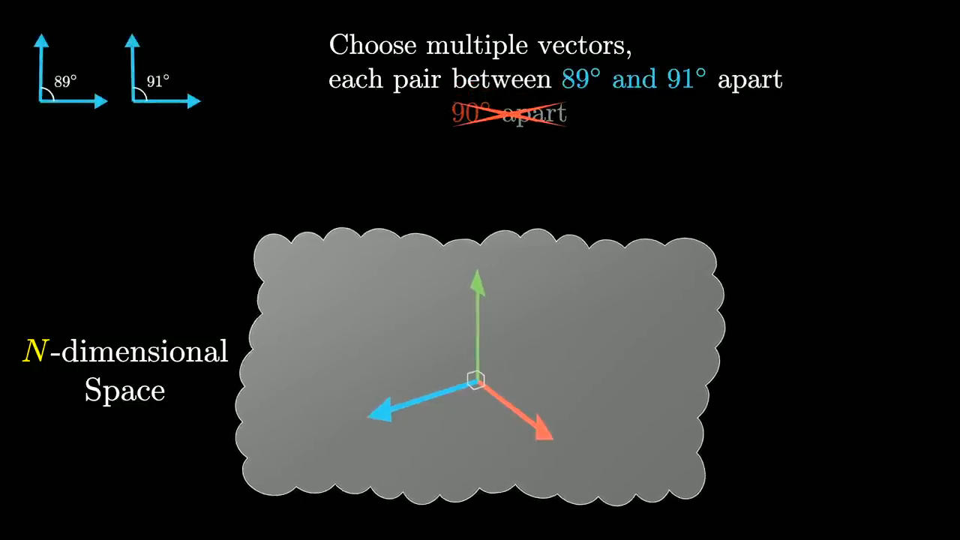

Slide 57
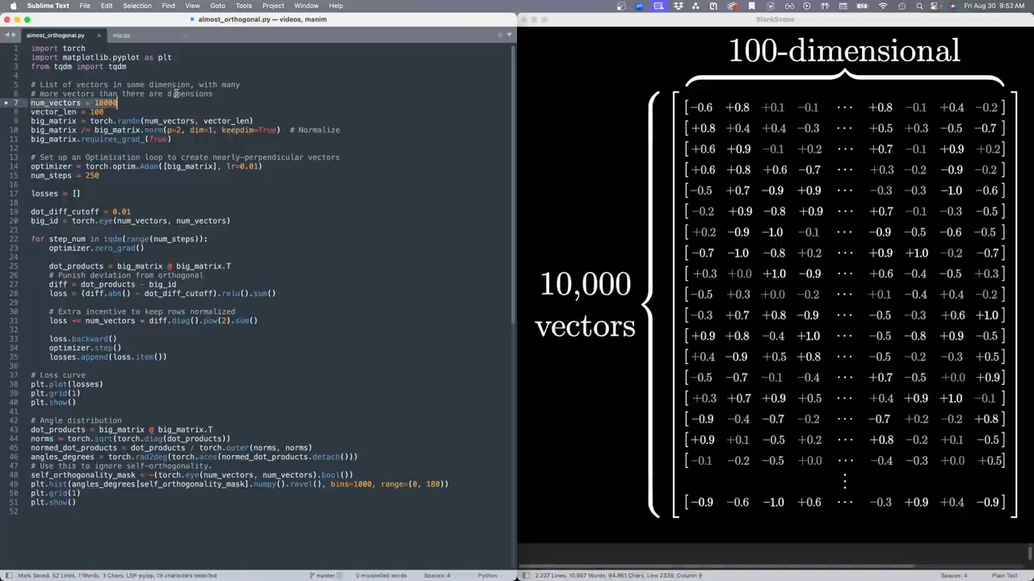

Slide 58
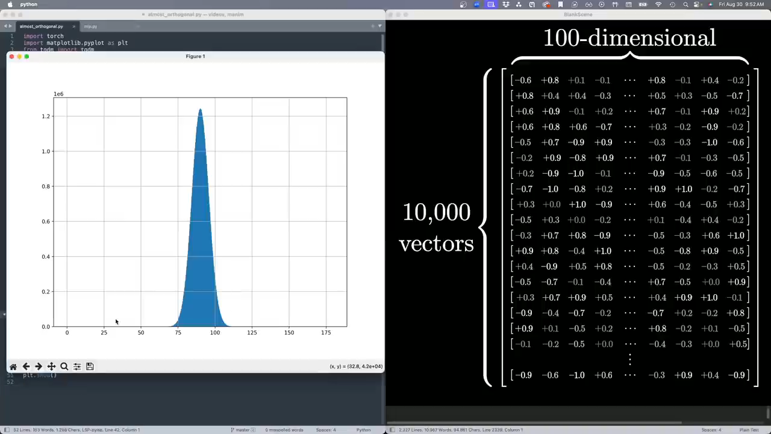

Slide 59
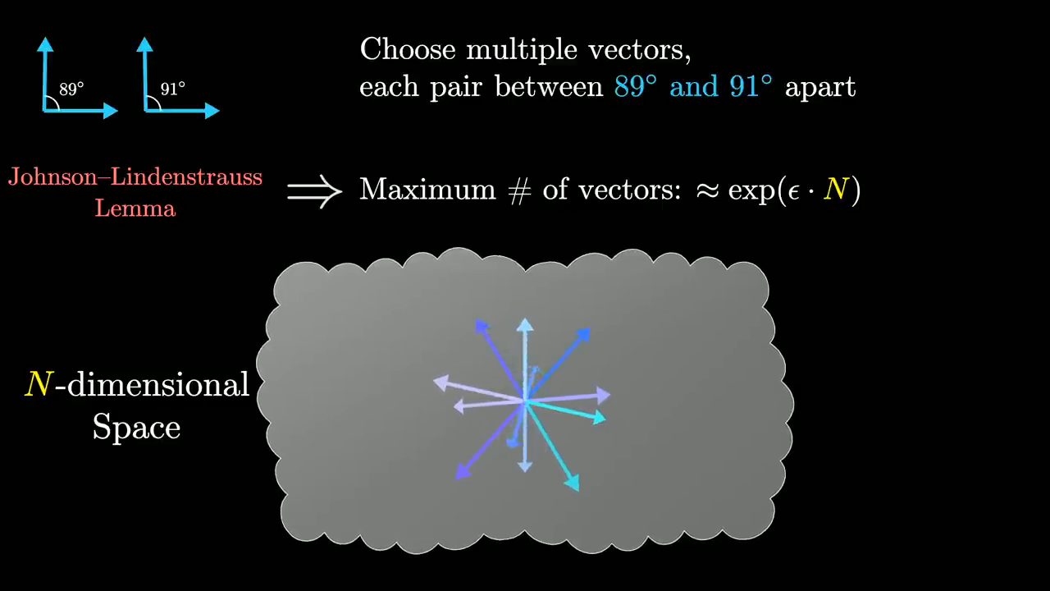

Slide 60
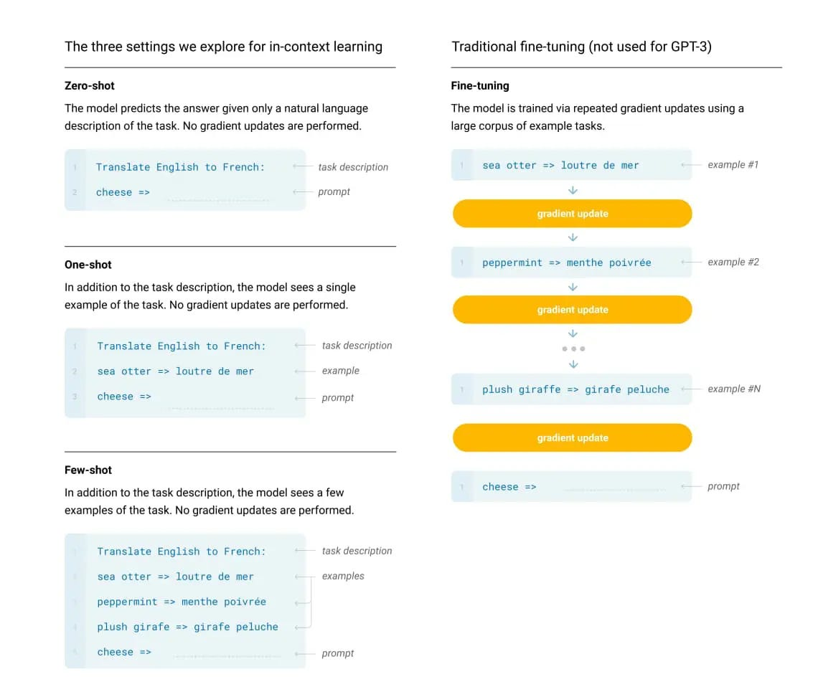
Few-shot learning
Machine Learning Methods for Biomedical Data (D012554)

Slide 61
DNA/protein LLMs
Transformer can process DNA, RNA, and protein sequences, learning meaningful patterns, mutations, and structural relationships.
Transformers for biomedical data are often pretrained on massive biological sequence databases to capture underlying biological structures and functional information.
Pretraining can achieved by training the model to predict masked nucleotides or amino acids.
Machine Learning Methods for Biomedical Data (D012554)

Slide 62
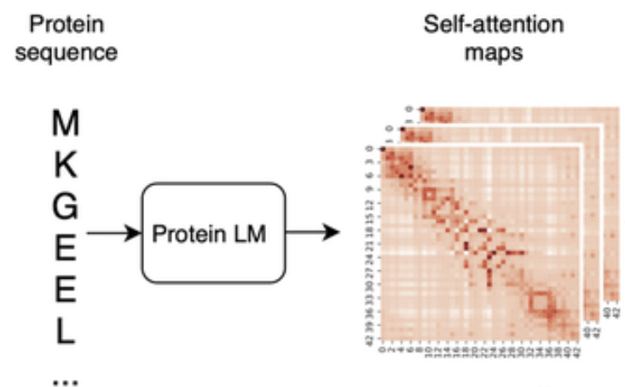
E.g. ESM2 (Evolutionary Scale Modeling v2)
ESM2 is a transformer-based protein language model that learns from massive protein sequence datasets, capturing evolutionary and functional properties of proteins through self-supervised learning.
Like BERT in NLP, ESM2 is trained using masked language modeling (MLM), where random amino acids in protein sequences are masked, and the model learns to predict them based on context. This forces ESM2 to understand protein grammar, structure, and evolutionary constraints.
Trained on millions of protein sequences (UniRef50), covering a broad spectrum of biological diversity across different organisms.
Rao et al., Transformer protein language models are unsupervised structure learners, bioRxiv, 2020
Machine Learning Methods for Biomedical Data (D012554)

Slide 63
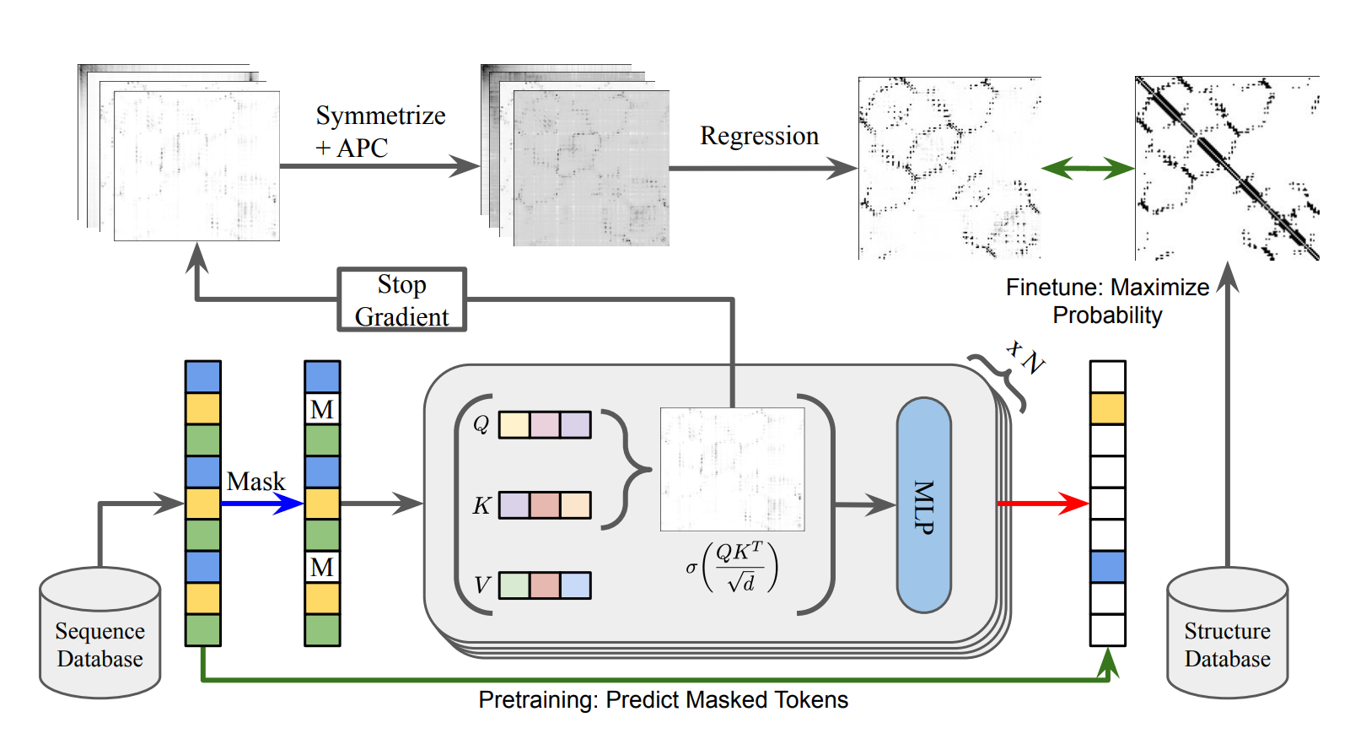
E.g. ESM2 (Evolutionary Scale Modeling v2)
Rao et al., Transformer protein language models are unsupervised structure learners, bioRxiv, 2020
Machine Learning Methods for Biomedical Data (D012554)

Slide 64
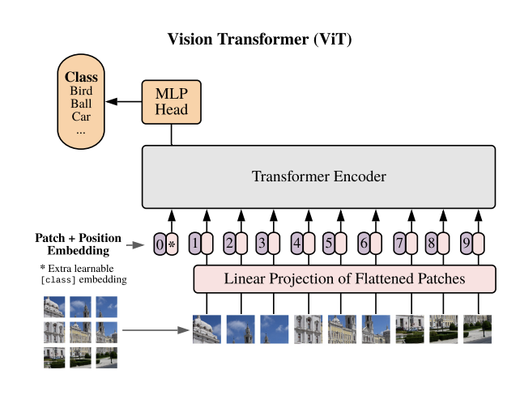
Vision Transformer (ViT)
The Vision Transformer (ViT) applies the self-attention mechanism from transformers to image data by dividing an image into small patches and processing them like a sequence of tokens.
ViT outperforms CNNs on large-scale datasets (e.g., ImageNet) by capturing long-range dependencies and global context more effectively.
ViT can be fine-tuned for various vision tasks (e.g., classification, object detection, segmentation) and benefits from pretraining on large datasets.
Dosovitskiy et al., An Image is Worth 16x16 Words: Transformers for Image Recognition at Scale, ICLR, 2021
Machine Learning Methods for Biomedical Data (D012554)

Slide 65
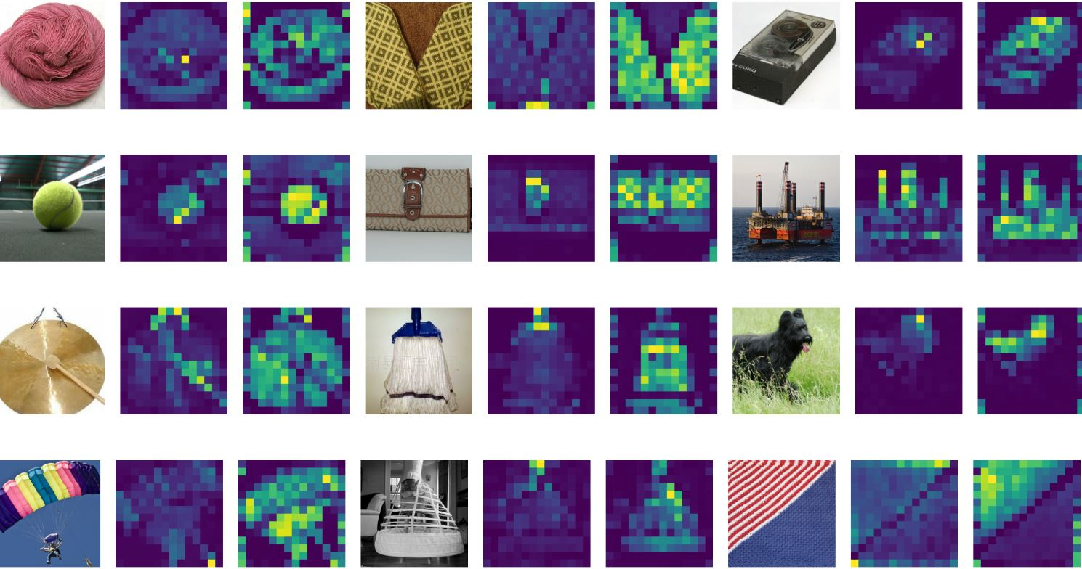
Vision Transformer (ViT) self attention
Machine Learning Methods for Biomedical Data (D012554)

Slide 66

Chat bots
openAI
Machine Learning Methods for Biomedical Data (D012554)

Slide 67
Retrieval-Augmented Generation (RAG)
RAG enhances Large Language Models (LLMs) by integrating external knowledge retrieval, improving accuracy and reducing hallucinations.
Retrieval phase: The model searches a knowledge base (e.g., FAISS, vector databases) to fetch relevant documents based on the user query.
Generation phase: The LLM processes retrieved documents alongside the query to generate informed, context-aware responses.
RAG is used in chatbots, research assistants, legal and medical AI, and any domain requiring precise, up-to-date information beyond pre-trained knowledge.
Machine Learning Methods for Biomedical Data (D012554)

Slide 68

Retrieval-Augmented Generation (RAG)
Medium.com
Machine Learning Methods for Biomedical Data (D012554)

Slide 69

Machine Learning Methods for Biomedical Data (D012554)

Slide 70

Machine Learning Methods for Biomedical Data (D012554)

Slide 71

Machine Learning Methods for Biomedical Data (D012554)

Slide 72

Machine Learning Methods for Biomedical Data (D012554)

Slide 73

Machine Learning Methods for Biomedical Data (D012554)

